Slide 1

Bi-layer simulation framework for adaptive path planning problem in crowd dynamics
Actions (2nd)
The URL of the photos obtained from website are added
Missing references and citation labels have been completed
The incorrectly used picture has been replaced (caused by the incorrect setting of the drawing parameters/ page 36).
Actions (3rd)
The wrong citations of figures have been corrected
The captions of the figures in the slides have been modified to be consistent with the thesis
Asakura Lab
Zhou Zixuan
18D58256

Slide 2
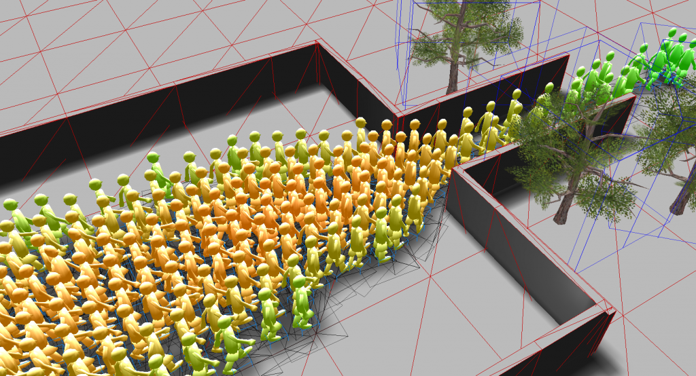
Crowd Dynamics Simulation Model
How does it work
At present, the measured data that can be used for pedestrian movement behavior, especially evacuation behavior research is very scarce:
Unexpected incidents under real circumstances have not been recorded in detail
There is still a big difference between the behaviors in experimental drill and real situations.
Empirical research is difficult to accurately perceive, describe, and set psychological preference.
Empirical research is expensive, time-consuming, and difficult to generalize to broad scenarios.
The vigorous development of computer technology has provided new opportunities for pedestrian simulation.
Note: Figure obtain from website (https://www.vadere.org/)

Slide 3
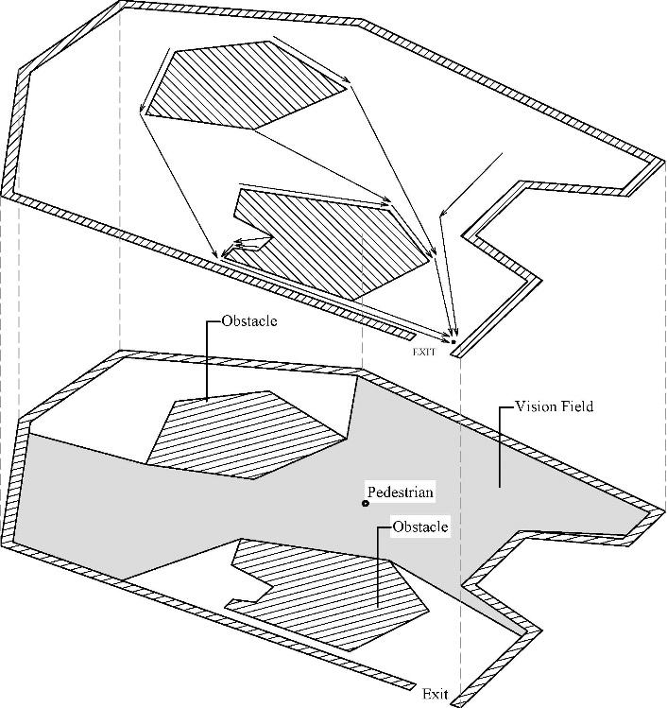
Bi-Layer Framework for Crowd Dynamics Simulation
Problem Formulation
The evacuees’ behavior can be seen as the result of a hierarchical decision-making process entailing three stages:
(1) strategic (choice to go towards a safe place)
(2) tactical (choice of routes and exits)
(3) operational (short-range choices concerning the interaction with obstacles and other evacuees)
The proposed modeling framework judiciously manages the trade-off between ability to accurately capture congestion phenomena resulting from the pedestrians’ collective behavior and scalability to model large facilities.
A novel hybrid simulation-assignment modeling that integrates path planning (tactical level) and trajectory planning (operational level) is proposed:
The top layer consists of a network representation of the facility, which enables modeling the pedestrians’ route planning decisions while performing their activities.
The bottom layer consists of a high resolution Agent-Based (AB) system for all open spaces, which enables modeling the pedestrians’ local maneuvers and movement decisions at a high level of detail.
Example of network and visual field representation.

Slide 4
Table of Contents
Chapter 1 - Introduction
Background
Main content and innovation
Chapter 2 - Literature Review
Pedestrian walking characteristics
Related methodologies
Path planning in microscopic models
Difficulties in the study of pedestrian movement
Motivation
Chapter 3 - Crowd Dynamics Model Formulation
Path planning in tactical layer
Operational layer movement pattern
Comparison with potential driven models
Chapter 4 – Pedestrian flow navigated by anthropomorphic regulation
Evacuation under conditions of completely visible and invisible
Evacuation under conditions with limited visibility
Interim summary

Slide 5
Table of Contents
Chapter 5 – Crowd dynamics simulation driven by machine learning guidance layer
Comparison among machine learning exit choice prediction approaches
Crowd dynamics with limited and global visual information
Interim summary
Chapter 6 – Multi-directional pedestrian flow simulation
Chapter 7 – Conclusions
References
Appendix

Slide 6
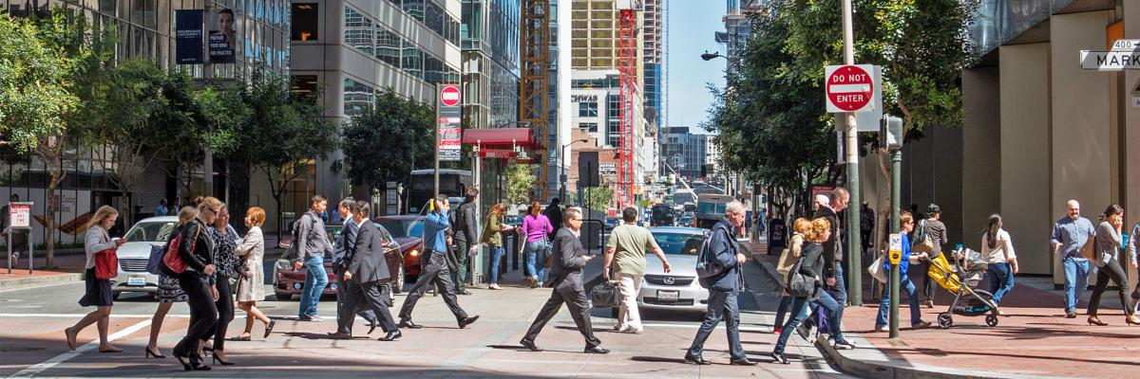
Chapter 1 Introduction
Background
No matter how the development of transportation has broadened the scope of human activity region, walking, as one of the oldest forms of motion method, is an important choice in short-distance travel.
Large-scale public facilities such as stadiums, shopping malls, transportation hubs, opera houses and other facilities have gradually become important entertainment and social places in daily life.
Improve the efficiency of pedestrian operation of transportation facilities and ensure the safety of pedestrians is a topic worthy of in-depth discussion.
Even in the same space, the psychological preferences of pedestrians are different. They may care about distance, time spent, comfort, visibility, peer preference, etc.
Note: Figure obtain from website (https://www.sfmta.com/san-francisco-made-walking)

Slide 7




Chapter 1 Introduction
Crowd Dynamics in Various Scenarios
Pedestrian walking be used as an independent travel mode to complete short-distance travel activities, or as a component of a travel activity chain to connect with other modes of transportation (Fig. 1).
Pedestrian flow can be regarded as a mixed flow of independent and multiple agents walking together (herding behavior) (Fig. 2).
In emergency situations, pedestrians are more concerned about time cost, while distance and comfort are more important reference factors in non-emergency situations (Fig. 3 & 4).
Pedestrians who are familiar with the spatial layout are more inclined to make independent decisions, while those who are unfamiliar tend to walk together.
Note: Figure obtain from website:
1) http://www.juimg.com/tupian/201211/mingxing_274453.html
2) https://iac-academy.com/play-hangout/
3) https://carleton.ca/emergency/procedures/emergency-evacuation-procedures/
4) https://www.nyhabitat.com/blog/2013/03/11/top-5-shopping-spots-london/

Slide 8
Chapter 1 Introduction
Scope of this work
Crowd Dynamics Simulation
Objective
Perspective
Efficiency
Accuracy
Microscopic
Mesoscopic
Macroscopic
Classification of the simulation methods
According to the focus of attention, pedestrian movement behavior research can be divided into two categories: 1) Pedestrian movement behavior under normal conditions 2) Pedestrian movement behavior under emergency conditions.
According to the movement direction of pedestrian groups: 1) unidirectional pedestrian flow and 2) multi-directional pedestrian flow (opposite pedestrian (bi-directional) flow & cross flow).
According to the completeness of perceivable information: Global perspective, limited perspective, zero visibility .
According to the decision-making mechanism of pedestrian in path planning: data-driven navigation and anthropomorphic regulation based navigation.
The compatibility of the model to various scenarios, spatial layout, and the role of the model in space design and evacuation planning also should be discussed.

Slide 9
Chapter 1 Introduction
Innovation of this work
The main purpose of this work is to propose a highly compatible crowd dynamics pedestrian simulation model that can adapt to most architectural spaces. It disassembles and expresses the decision-making behaviors of pedestrians at various levels in the movement in turn, and can be applied to various scenarios. This model can be used to predict pedestrian movement in specific scenarios, and can also assist in the design of space planning and pedestrian flow guidance systems.
Aiming at the defects of inaccurate information collection and vague quantification methods in the past models, a processing method based on visual perception method is proposed.
This work provides a generalized framework for establishing crowd dynamics model for the space with random distributed obstacles and visibility occlusion.
The decision-making preferences of pedestrians in the model will change with the progress of the movement.
This work bridge the gap between experimental analysis and numerical simulation in the field of crowd dynamics by providing a data-driven microscopic model.
The formulation method of this model describes the behavior of pedestrians in more detail, so that it can be applied to various scenarios (such as emergency and non-emergency) and can be used to evaluate the design schemes of various building spaces or pedestrian flow guidance system.

Slide 10
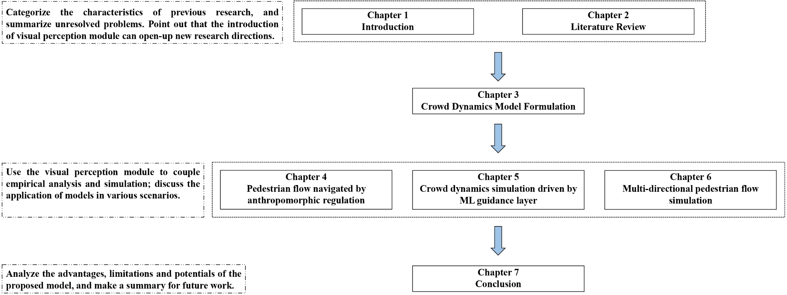
Chapter 1 Introduction
Organization of this thesis
This thesis systematically combs the achievements in previous studies, and attempts to combine theoretical modeling and empirical research to further explore the complex motion and interactive behavior mechanism of pedestrian traffic flow. Based on these mechanisms, the pedestrian movement in a variety of scenes are discussed to provide references and suggestions for space design, pedestrian flow guidance, and evacuation planning.

Slide 11
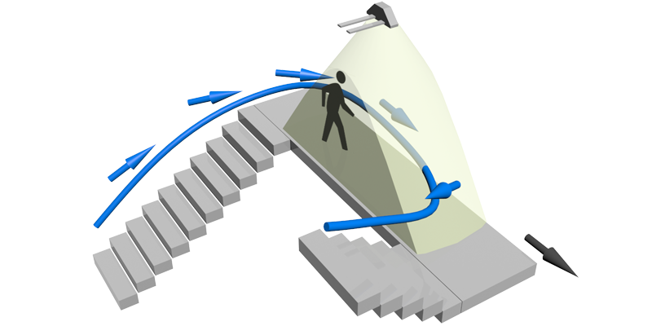
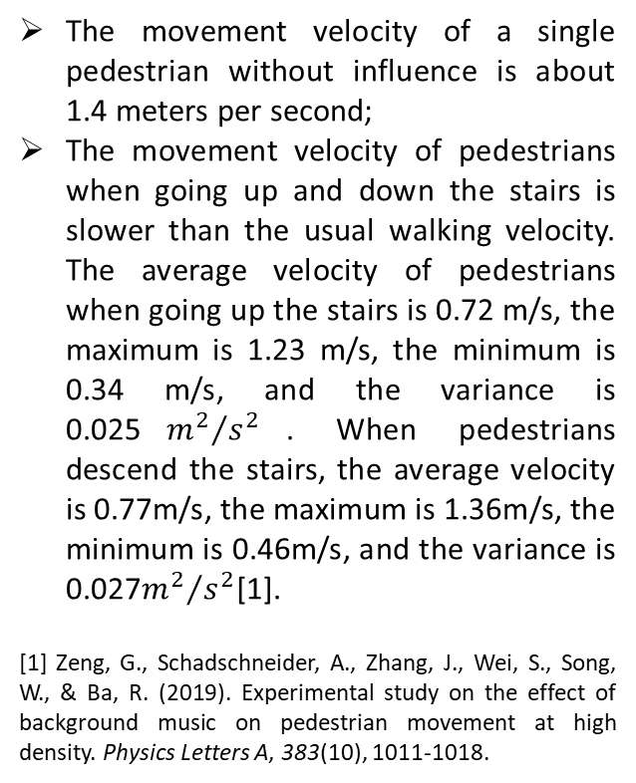
Chapter 2 Literature Review
Pedestrian Walking Characteristics
Pedestrian velocity measurement results in related literature
The movement velocity of a single pedestrian without influence is about 1.4 meters per second;
The movement velocity of pedestrians when going up and down the stairs is slower than the usual walking velocity. The average velocity of pedestrians when going up the stairs is 0.72 m/s, the maximum is 1.23 m/s, the minimum is 0.34 m/s, and the variance is 0.025${m^{2}}/{s^{2}}$. When pedestrians descend the stairs, the average velocity is 0.77m/s, the maximum is 1.36m/s, the minimum is 0.46m/s, and the variance is 0.027${m^{2}}/{s^{2}}$[1].
[1] Zeng, G., Schadschneider, A., Zhang, J., Wei, S., Song, W., & Ba, R. (2019). Experimental study on the effect of background music on pedestrian movement at high density. Physics Letters A, 383(10), 1011-1018.

Slide 12
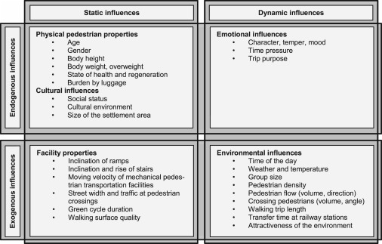
Chapter 2 Literature Review
Pedestrian Walking Characteristics
Previous studies have collected pedestrian movement speeds in various scenarios and summarized related influencing factors.
Different influencing factors were considered for different purposes and different environments, such differences produced a large number of methods and results for measuring pedestrian velocities.[1]
In the modeling formulation, the velocity of individual is usually modeled for a specific scenario, and then the velocity is calibrated.
Influences on the pedestrian walking velocity [1]
[1] Bosina, Ernst & Weidmann, Ulrich. (2016). Estimating pedestrian speed using aggregated literature data. Physica A: Statistical Mechanics and its Applications. 468. 10.1016/j.physa.2016.09.044.

Slide 13
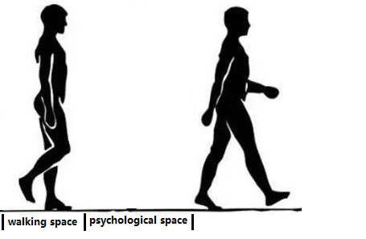
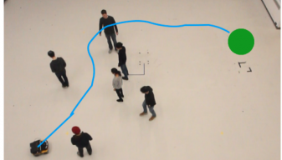
Chapter 2 Literature Review
Pedestrian Walking Characteristics
Interaction among pedestrians
Space requirement
Static space requirement: Including the space occupied by the pedestrian's body and the space for psychological expectations.
Dynamic space requirement: In addition to the static space requirements, the space required for necessary sports activities.
Trajectory adjustment
In order to meet the pedestrian's requirement for space, individuals will adjust their trajectories individually or cooperatively to avoid others.
Unilateral interaction
Mutual interaction
Example of distance between pedestrians in walking [1]
Example of trajectory adjustment during walking [2]
[1] Figure obtained from website: https://www.tutorialspoint.com/positive_body_language/positive_body_language_walk_smart.htm
[2] Everett, M., Chen, Y. F., & How, J. P. (2021). Collision avoidance in pedestrian-rich environments with deep reinforcement learning. IEEE Access, 9, 10357-10377.

Slide 14
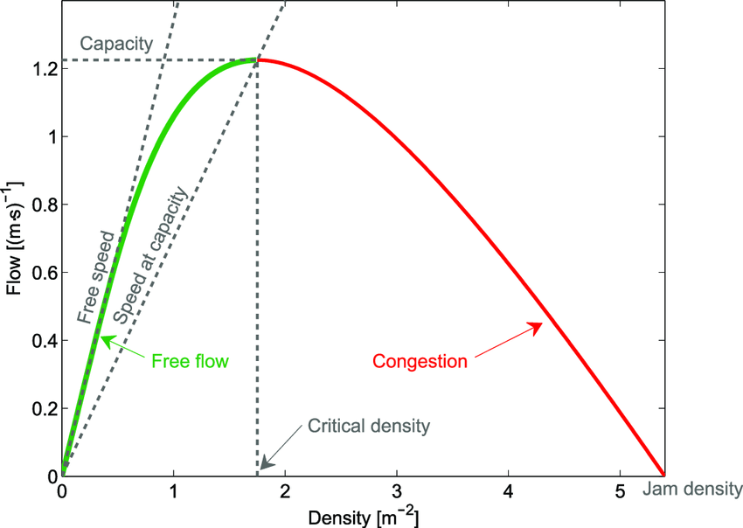
Chapter 2 Literature Review
Pedestrian Walking Characteristics
Pedestrian flow characteristics
Generally speaking, the macroscopic phenomenon of pedestrian movement in a normal environment is similar among all situations. Therefore, there is a certain statistical relationship among the three elements of velocity, flow, and density, which is also called fundamental diagram [1].
Similar to the measurement of pedestrian speed, the relationship between speed and density has countless corresponding relationships and fitting formulas due to scenario diversity.
The fundamental diagram provides a valuable reference for the simulation results of the micro model, and can assist in qualitative analysis.
Its limitation lies in its low compatibility and cannot be easily applied to various scenarios. At the same time, unlike vehicles on the road that follow unidirectional movement, the direction of movement of pedestrians is omnidirectional. Therefore, it is very difficult to measure the density and speed of pedestrians.
Flow–density representation of the fundamental diagram for pedestrian motion [1]
[1] Weidmann U. Transporttechnik der Fussga¨nger: Transporttechnische Eigenschaften des Fussga¨nger-verkehrs (Literaturauswertung). ETH, IVT; 1993

Slide 15
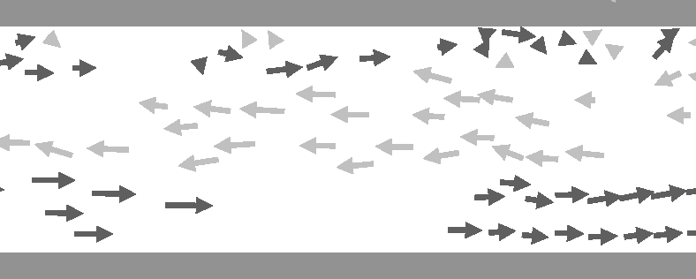
Chapter 2 Literature Review
Pedestrian Walking Characteristics
Self organization phenomenon [1]
Although pedestrians have individual preferences, aims, and destinations, the dynamics of pedestrian crowds is surprisingly predictable. Pedestrians can move freely only at small pedestrian densities. Otherwise their motion is affected by repulsive interactions with other pedestrians, giving rise to self-organization phenomena. Self-organization behavior includes: Herding Behavior, Dynamic lane formation, Fast is slower (FIS) effect, Stripe formation
In the field of theoretical research, since the authentic reason for the phenomenon must be depicted in microscopic modeling, instead of modifying the coefficients in order to make up specific phenomena, if the microscopic model can spontaneously generate a convincing self-organizing phenomenon, such a model will be very valuable for research.
[1] Helbing, D. (1997). Self-Organization Phenomena in Pedestrian Crowds Dirk Helbing and Péter Molnár II.

Slide 16
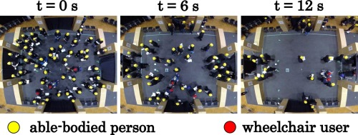
Chapter 2 Literature Review
Related Methodologies (Empirical Analysis)
Example of crowd dynamics experiments [1]
The core goal of empirical research on pedestrian movement behavior is to obtain intuitive data on pedestrian behavior and related characteristics during ordinary and emergency scenarios. This is not only the most direct and reliable evidence for analyzing pedestrian behavior, but also the basis for pedestrian modeling and simulation. However, the current empirical data in this research field is too scattered, and even confusing and contradictory in some cases.
Early research on pedestrian movement mainly used field observations in various pedestrian walking facilities to obtain some basic characteristics of pedestrian walking, including velocity and flow under different density conditions, in order to provide data support for the improvement on the design and service level of pedestrian facilities. By the mid to late 1990s, the rise of the Social Force (SF) Model and the Cellular Automaton (CA) Model provided a solid theoretical framework for the study of pedestrian dynamics, and triggered a large number of microscopic simulations.
[1] Feliciani, C., Murakami, H., Shimura, K., & Nishinari, K. (2020). Efficiently informing crowds–experiments and simulations on route choice and decision making in pedestrian crowds with wheelchair users. Transportation research part C: emerging technologies, 114, 484-503.

Slide 17
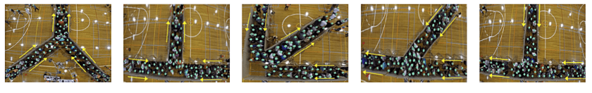
Chapter 2 Literature Review
Related Methodologies (Empirical Analysis)
Controllable laboratory experiment:
Researchers can easily build, design or adjust the structure and size experimental field to match various research scenarios according to the research content;
The relevant attributes of the experimenter, such as age, gender, etc., can be controlled during the recruitment process to achieve the desired effect;
Compared with actual observations, it is more conducive to the experiment designer to control the experimental conditions and other related factors;
High repeatability and contrast improves the reliability of experimental data, and is also convenient for other researchers to reproduce and conduct parallel comparisons;
It is convenient to choose a favorable shooting location to install the camera and improve the accuracy of post-processing data extraction;
Compared with animal experiments, more realistic pedestrian behavior data can be obtained from volunteers.
A series of experiments simulated the evacuation of human crowds from the confined environment (figures taken from fig.1 of [1])
[1] Shahhoseini, Z., & Sarvi, M. (2019). Pedestrian crowd flows in shared spaces: Investigating the impact of geometry based on micro and macro scale measures. Transportation research part B: methodological, 122, 57-87.

Slide 18
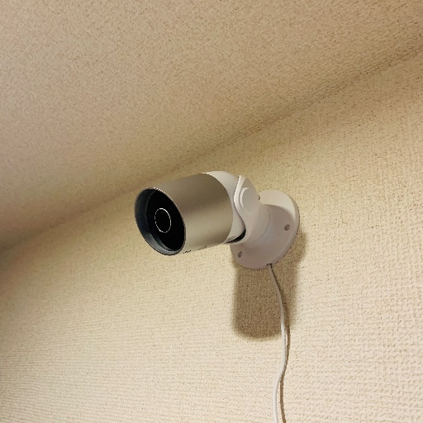
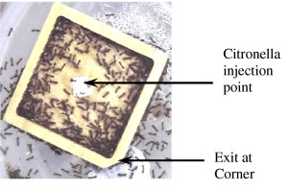
Chapter 2 Literature Review
Related Methodologies (Empirical Analysis)
Video analysis of actual pedestrian movement
Use surveillance videos of relevant places or videos taken by the researchers themselves in pedestrian activities to extract and analyze various behavioral characteristics of pedestrians during movement. Compared with controllable experiments under laboratory conditions, the data obtained in this way is more realistic, especially the analysis of some disaster accident surveillance videos can get the most realistic pedestrian response to emergency situations.
Animal experiment [1]
Pedestrian evacuation behavior in emergency situations has always been of interest to researchers, but general pedestrian movement experiments and evacuation drills are not allowed in emergency situations to ensure the safety of personnel. Using some animals with obvious group characteristics to do experiments can avoid the consideration of safety issues to a certain extent, and gain enlightenment on human group movement behaviors.
Virtual reality experiment
Virtual reality experiments through computer simulation technology are more convenient in scene design and experiment control.
Example of animal experiment[1]
[1] Shiwakoti, N., Sarvi, M., Rose, G., & Burd, M. (2011). Animal dynamics based approach for modeling pedestrian crowd egress under panic conditions. Procedia-social and behavioral sciences, 17, 438-461.

Slide 19
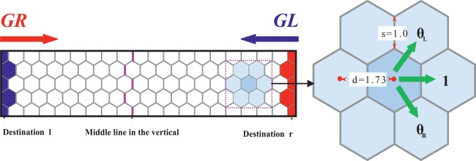
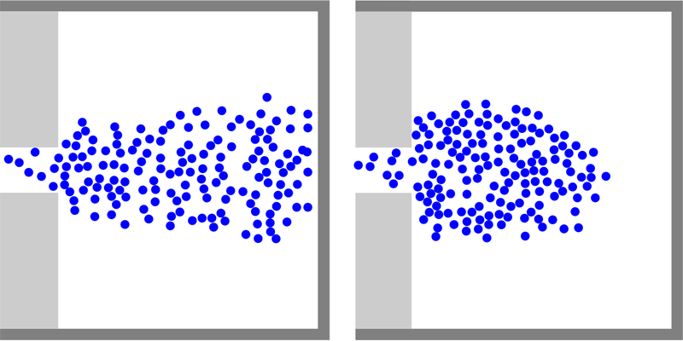
Chapter 2 Literature Review
Related Methodologies (Numerical Simulation)
The macroscopic characteristics of pedestrian flow mainly include the value and relationship of the three basic parameters (density, speed and flow rate), and the temporal and spatial variation characteristics of the three parameters.
Macroscopic simulation model [1]
Mesoscopic models consider pedestrians as individuals, but describe their propagation by aggregate relationships. They are better at incorporating and providing population heterogeneity than macroscopic models, and typically more efficient than microscopic models.
Mesoscopic simulation model [2]
Microscopic models are widely recognized and promoted in practical applications and research because they can meticulously describe the behavioral characteristics of each individual.
Microscopic simulation model [3]
[1] Shiwakoti, N., Sarvi, M., Rose, G., & Burd, M. (2011). Animal dynamics based approach for modeling pedestrian crowd egress under panic conditions. Procedia-social and behavioral sciences, 17, 438-461.
[2] Xu, H. H., & Guo, R. Y. (2018). Simulation of bi-directional pedestrian flow by using a cell transmission model. Simulation Modelling Practice and Theory, 87, 1-14.
[3] Seitz, M. J., Dietrich, F., Köster, G., & Bungartz, H. J. (2016). The superposition principle: A conceptual perspective on pedestrian stream simulations. Collective Dynamics, 1, 1-19.

Slide 20
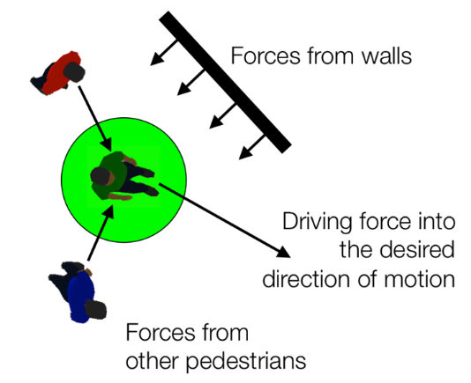
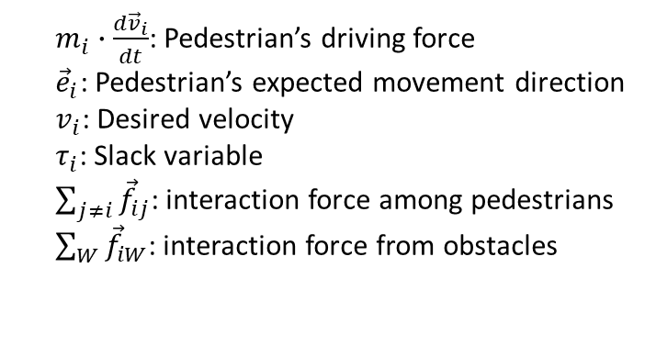
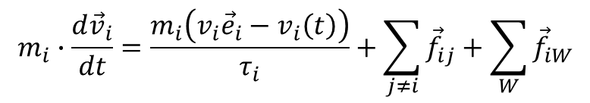
Chapter 2 Literature Review
Related Methodologies (Numerical Simulation)
Two classical microscopic models
In the social force model, the movement of pedestrians is affected by their own driving force, the interaction force with other pedestrians, and the influence of obstacles such as walls on its force. The model can reproduce many collective phenomena (e.g., lane formation, and the “faster is slower” effect). The driving formula for pedestrians is as follows:
$$m_{i}∙\frac{{d\vec{v}}_{i}}{dt}=\frac{m_{i}\left(v_{i}{\vec{e}}_{i}−v_{i}\left(t\right)\right)}{τ_{i}}+\sum_{j≠i}{{\vec{f}}_{ij}}+\sum_{W}{{\vec{f}}_{iW}}$$
$m_{i}∙\frac{{d\vec{v}}_{i}}{dt}$: Pedestrian’s driving force
${\vec{e}}_{i}$: Pedestrian’s expected movement direction
$v_{i}$: Desired velocity
$τ_{i}$: Slack variable
$\sum_{j≠i}{{\vec{f}}_{ij}}$: interaction force among pedestrians
$\sum_{W}{{\vec{f}}_{iW}}$: interaction force from obstacles
Social Force (SF) model [1]
[1] Helbing, D., & Molnar, P. (1995). Social force model for pedestrian dynamics. Physical review E, 51(5), 4282.

Slide 21
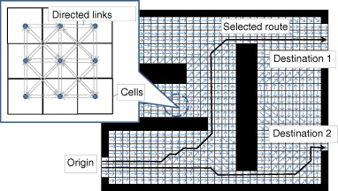
Chapter 2 Literature Review
Related Methodologies (Numerical Simulation)
Two classical microscopic models
Since the potential based model is applied to pedestrian simulation, it has been widely recognized and developed. This kind of model meshes the space into small girds (cell), and drive the individual by the differential pressure among those girds.
Easy to formulate
High computational efficiency
Excellent behavioral performance
Concise conflict resolution methods
Example of potential based model [1]
[1] Asano, M., Iryo, T., & Kuwahara, M. (2010). Microscopic pedestrian simulation model combined with a tactical model for route choice behaviour. Transportation Research Part C: Emerging Technologies, 18(6), 842-855..

Slide 22
Chapter 2 Literature Review
Related Methodologies (Numerical Simulation)
Two classical microscopic models
SF model:
This model uses continuous external forces to drive individuals, so obviously it can only describe the movement of pedestrians in the first-order space, and cannot simulate the sudden stop, sudden turn, and other discontinuous movements of pedestrians. Of course, since an imaginary force is introduced, the setting of this force is inevitably different from the reality. For example, we observe that when pedestrians approach a wall with different velocities, the repulsive forces exerted on them depend only on the distance between them and the wall.
CA model:
The method of space division, the movement pattern of pedestrians, and the definition of potential determine the inherent characteristics and defects of this model.
Unrealistic results in high-density situation
Low compatibility with space layout
Hysteresis in potential (information) transmission
…

Slide 23
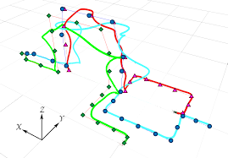
Chapter 2 Literature Review
Path Planning in microscopic models
Evaluation of path utility
Irregularity of the interior space of the building and uncertainty in utility evaluation on different paths directly affects pedestrian's travel time and trajectory, and also affects the evacuation efficiency of pedestrian flows.
Some approaches do not consider tactical and operational level behavior separately
The parameters needed to assess the utility of the path are difficult to measure
The relationship between related parameters and path utility is fuzzy
The evaluation methods of each model are incompatible and difficult to apply to other scenarios
Pedestrian in different situations holds different decision-making preferences
Pedestrians tend to follow the direction of a large number of people when they are far from the exit, and show congestion aversion when they are close to the exit.
Pedestrians care about time cost in emergency situations, and care about distance and comfort in non-emergency situations

Slide 24
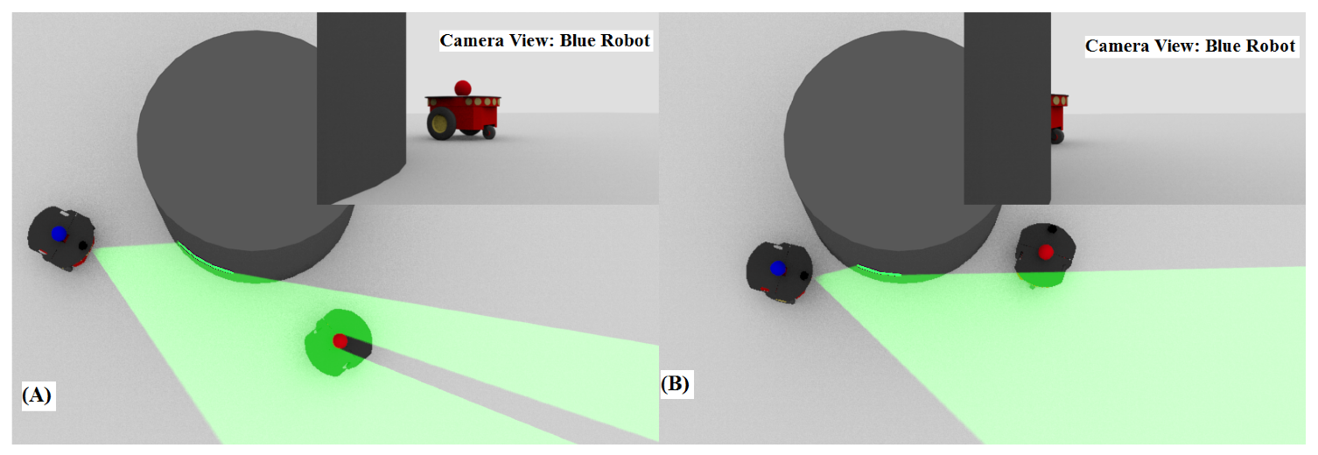
Chapter 2 Related Methodologies
Path Planning in microscopic models
Information perception in consideration of visual occlusion
Humans have a variety of perception methods to understand the state of the surrounding environment, such as auditory, visual, olfactory, and tactile information. Admittedly, in the moving process of pedestrian, the most important information comes from observation.
The perception of visual information is instantaneous
Pedestrians receive static and dynamic information in the field of view completely
Information outside the field of view cannot be used for path planning
Obstacles and brightness in the venue will affect the reception of visual information
Example of a visual occlusion created by obstacle [1]
[1] Bechlioulis CP, Vlantis P, Kyriakopoulos KJ. Coordination of Multiple Robotic Vehicles in Obstacle-Cluttered Environments. Robotics. 2021

Slide 25
Chapter 2 Related Methodologies
Difficulties in the Study of Crowd Dynamics
The complexity and variability of pedestrian behavior
Different pedestrians may have different reactions to the same situation; the same pedestrian may also show different behavior characteristics at different times and occasions.
The criteria for measuring the characteristics that affect pedestrians' decision-making are ambiguous
Congestion
Congestion-Velocity Relationship (k-d)
Attraction or aversion towards others
The continuity and diversity of the pedestrian movement space
The movement of pedestrians is much more flexible, and the movement space can be said to be almost continuous, the direction is omnidirectional, and it is rarely restricted or regulated.
Behavior characteristics observed in real scenes are difficult to transform into mathematical models
Models often simplify the logic of pedestrian behavior, which can improve the efficiency of the model, but it also makes it difficult to promote, improve, and provide a reference for architecture design.
The compatibility of numerical simulation is insufficient, and the application scenarios corresponding to each model are relatively single

Slide 26
Chapter 2 Related Methodologies
Motivation
Based on the achievement made by previous research, this work will make some supplements and improvements in the refinement and generalization of the model. In order to solve the problems mentioned in the previous section, this measures can be summarized in the following four aspects:
Increase the visual realism of crowd dynamics modeling by getting rid of hypothetical regulation;
Extend the scope of the adaptability and investigate unexplored but significant factors;
Bridge the gap between empirical analysis and simulation methods;
Discuss the application prospects of the model in building space assessment, and put forward guiding opinions on space design and pedestrian flow planning.
Static/Dynamic information
Dynamic window approach
Visual information Perception
Path Planning
Trajectory Planning
Collision avoidance
Update Position and Velocity
Remove redundant routes
ORCA method
Optional path set
Path cost calculation
(Time base/ Data driven
Tactical Level
Operational Level

Slide 27
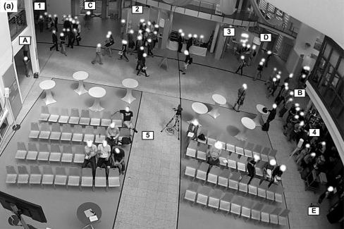
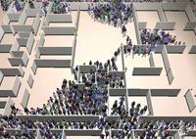
Chapter 3 Crowd Dynamics Model Formulation
Pedestrian behavior during an evacuation can be divided into the following three levels, with mutual dependencies:
Strategic level (departure time choice and activity pattern choice)
Tactical level (activity scheduling, activity area choice, and route choice)
operational level (direction and speed)
Pedestrian decision making hierarchy[1]
Connection between E/S study
Characteristic description
Utility consistency
Decision regulation
Kinetics modeling
Empirical research [2]
Simulation [3]
[1] Haghani, M., & Sarvi, M. (2016). Pedestrian crowd tactical‐level decision making during emergency evacuations. Journal of Advanced Transportation, 50(8), 1870-1895.
[2] Kielar, P. M., & Borrmann, A. (2016). Modeling pedestrians’ interest in locations: A concept to improve simulations of pedestrian destination choice. Simulation Modelling Practice and Theory, 61, 47-62.
[3] Guy, S. J., Chhugani, J., Kim, C., Satish, N., Lin, M., Manocha, D., & Dubey, P. (2009, August). Clearpath: highly parallel collision avoidance for multi-agent simulation. In Proceedings of the 2009 ACM SIGGRAPH/Eurographics Symposium on Computer Animation (pp. 177-187).

Slide 28
Chapter 3 Crowd Dynamics Model Formulation
Path planning in tactical layer
Networking the spatial layout of facility
In upper layer, a network is established based on the space shape and internal obstacle distribution. An agent uses the information accessible from its current position to calculate the expected time cost of each optional path and then selects the optimal one. In the local navigation, the pedestrian will move along the selected path decided by the global guidance layer.
In computation graph and robot motion planning, a visibility graph is always used to find the Euclidean shortest path between two points blocked by obstacles in a continuous space. In this model, the visibility graph is a network whose nodes are the vertices of the obstacles, wall corners with reflexive angles, and exits and whose edges connect all the mutually visible node pairs; if two nodes are visible to each other, an arc can be constructed between them, without intersecting structural components or internal obstacles.

Slide 29
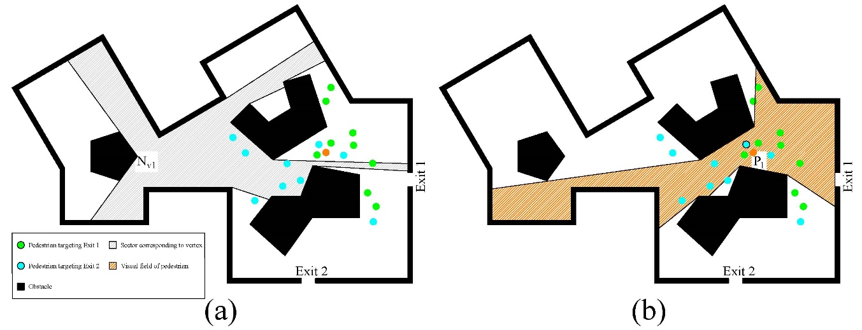
Chapter 3 Crowd Dynamics Model Formulation
Path planning in tactical layer
Visual field at specific position in the space
Static information
Nodes in the route network
Exit, obstacle
Distance of each link
Dynamic information (state of other pedestrians)
Coordinate
Velocity
Size
Choice
Visual field definition
Set of triangles
Difference in Boolean operation
Contents of nodes in network
Exits
Vertices of obstacles
Corner of reflexive angle on the boundary

Slide 30
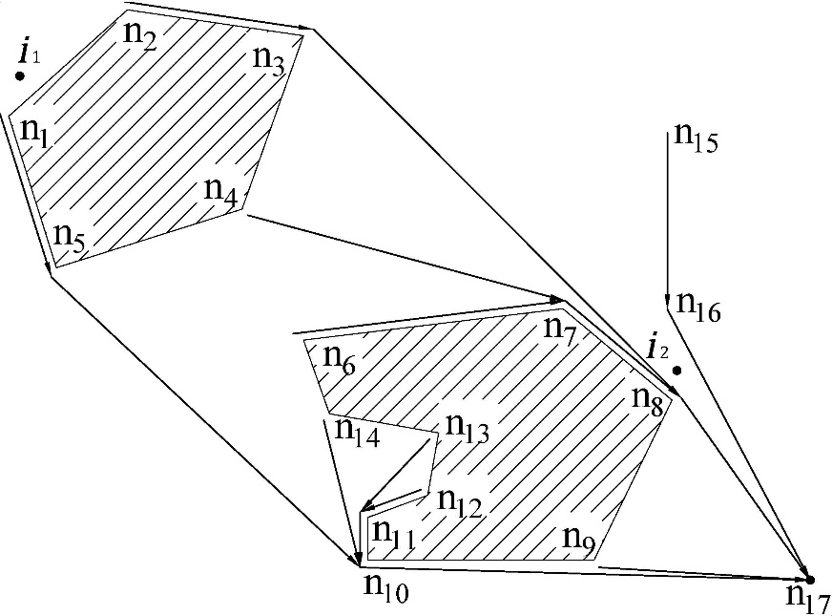
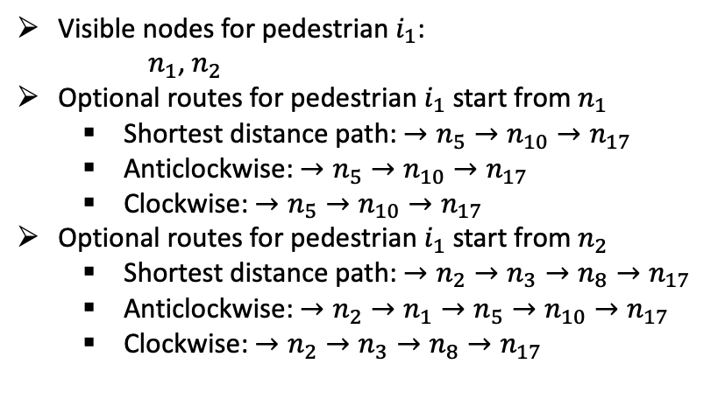
Chapter 3 Crowd Dynamics Model Formulation
Path planning in tactical layer
Generating feasible routes
The shortest path in space must be a polyline composed of line segments between nodes, not a curve
Even if we only consider the polyline formed by network nodes, there are still countless paths
only two kinds of routes are taken into consideration: 1) the shortest paths from visible nodes; 2) the shortest paths from neighbors of the visible nodes, which represents clockwise and anticlockwise movement around the obstacles.
Visible nodes for pedestrian $i_{1}$:
$n_{1}$, $n_{2}$
Optional routes for pedestrian $i_{1}$ start from $n_{1}$
Shortest distance path: $→n_{5}→n_{10}→n_{17}$
Anticlockwise: $→n_{5}→n_{10}→n_{17}$
Clockwise: $→n_{5}→n_{10}→n_{17}$
Optional routes for pedestrian $i_{1}$ start from $n_{2}$
Shortest distance path: $→n_{2}→n_{3}→n_{8}→n_{17}$
Anticlockwise: $→n_{2}→n_{1}→n_{5}→n_{10}→n_{17}$
Clockwise: $→n_{2}→n_{3}→n_{8}→n_{17}$
A part of oriented graph generated based on facility

Slide 31
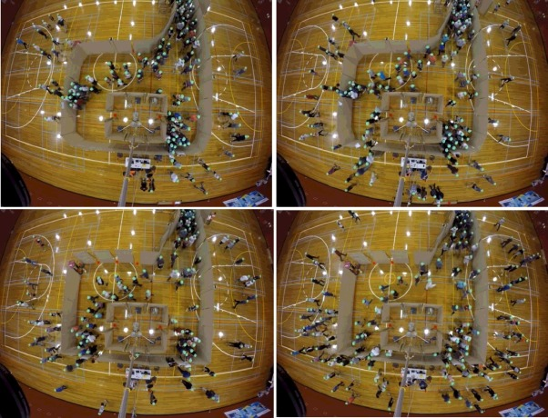
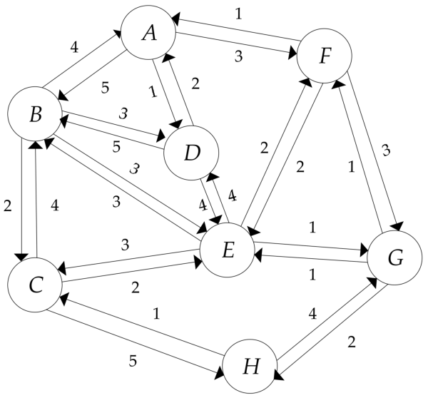
Chapter 3 Crowd Dynamics Model Formulation
Path planning in tactical layer
Path utility evaluation
Data driven path planning: It has been widely observed that socially compliant navigation is still difficult to quantify due to the stochasticity in pedestrian's path planning behavior. One way to circumvent this dilemma is to make path decisions directly through pedestrian data.
Time-based path planning: Pedestrian flow is a common phenomenon under various scenarios, but the matching data can not be found in all situations to train the model.
Evacuation drills conducted in pre-designed site. The models in my work are trained by the data obtained from this study [1]
Example travel cost of the link in route network [2]
[1] Haghani, M., & Sarvi, M. (2017). Stated and revealed exit choices of pedestrian crowd evacuees. Transportation Research Part B: Methodological, 95, 238-259.
[2] Qiao, T., Shan, W., Yu, G., & Liu, C. (2018). A novel entropy-based centrality approach for identifying vital nodes in weighted networks. Entropy, 20(4), 261.
Notes:
Fig 4 in majid paper show figure number

Slide 32
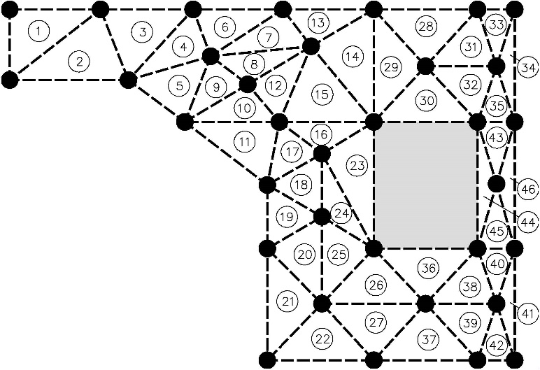
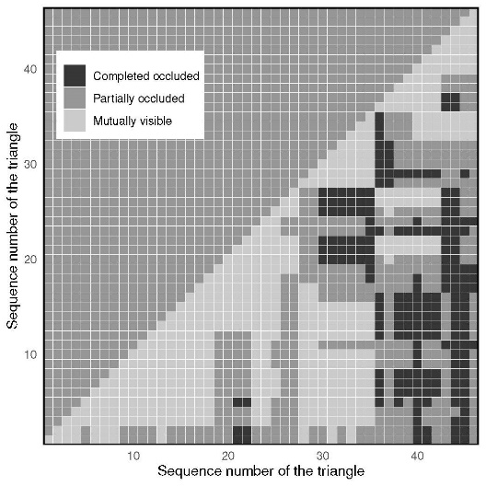
Chapter 3 Crowd Dynamics Model Formulation
Path planning in tactical layer
Delaunay triangulation of the set contains vertices and intersection points
Mutual visibility of among pedestrians located in triangles
Judgment of mutual visibility among pedestrians (Visual information perception)
Extend the edges of the obstacle to generate joint points with other edges or extended lines.
Construct a Delaunay triangulation on the set of obstacle vertices, wall corners with reflexive, exits, and joint points generated in last step to mesh the space into triangle set.
Divide the triangles with sides longer than the minimum obstacle thickness until all the triangle sides meet the requirement and conduct Delaunay triangulation locally.
For each pair of triangles, extract the line segments with the vertices of two triangles as its endpoints and separate the other vertices on one side of it via enumeration.
Check whether the line segment pair is occluded by obstacles and mark the relationship between each pair of triangles: 1) completely occluded by one obstacle; 2) partially occluded or occluded by different obstacles; and 3) no occlusion.

Slide 33
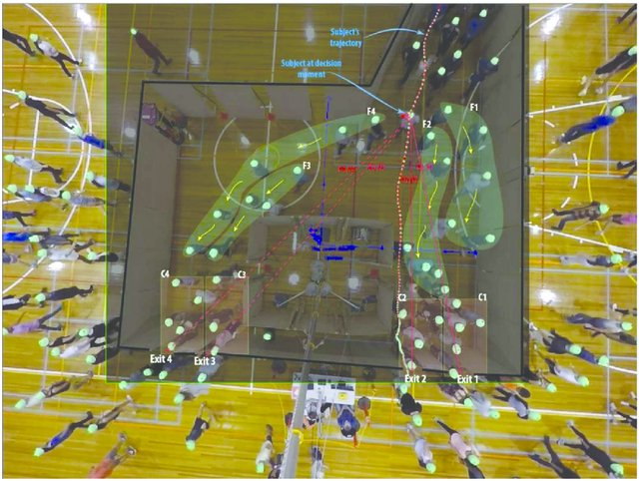
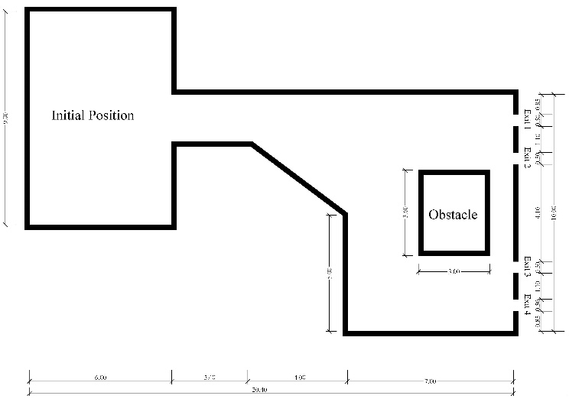
Chapter 3 Crowd Dynamics Model Formulation
Path planning in tactical layer
Extracting volunteers’ decision-making behavior from the field-type evacuation experiments [1]
Configuration of the space for evacuation experiments, reproduced according
to the size instruction in figure 2 of Haghani’s work [2]
[1] Haghani M, Sarvi M, Shahhoseini Z, Boltes M (2016) How Simple Hypothetical-Choice Experiments Can Be Utilized to Learn Humans’ Navigational Escape Decisions in Emergencies. PLOS ONE 11(11): e0166908. https://doi.org/10.1371/journal.pone.0166908
[2] Haghani, M., & Sarvi, M. (2018). Hypothetical bias and decision-rule effect in modelling discrete directional choices. Transportation Research Part A: Policy and Practice, 116, 361-388.

Slide 34
Chapter 3 Crowd Dynamics Model Formulation
Path planning in tactical layer
Classification model
Model training
This work uses several common supervised learning methods for data classification, specifically: Adaboost (ADB), Bagging, Decision Tree (DT), Gradient Boosting Decision Tree (GBDT), K-Nearest Neighbor (KNN), Logistic Regression (LR), Multi-Layer Perception (MLP), Random Forest (RF) and Support Vector Machine (SVM).
Feature selection
For each single record of pedestrian exit choice, 4 variables will be recorded (Full data can be found in the supplement of previous study [1]).
Dist: Distance
Vis: Visibility of the exit
Cong: Number of pedestrians at exit
F_N: Number of selections
id | Exit_id | Exit_N | Vis | Dist | F_N | Cong | Choice
1 | 1 | 4 | T | 11.082 | 3 | 4 | F
1 | 2 | 4 | F | 11.203 | 5 | 9 | F
1 | 3 | 4 | F | 13.198 | 1 | 2 | T
1 | 4 | 4 | T | 14.231 | 4 | 7 | F
Sample of single record of pedestrian (ID: 1) exit choice
[1] Haghani, M., & Sarvi, M. (2017). Stated and revealed exit choices of pedestrian crowd evacuees. Transportation Research Part B: Methodological, 95, 238-259.

Slide 35
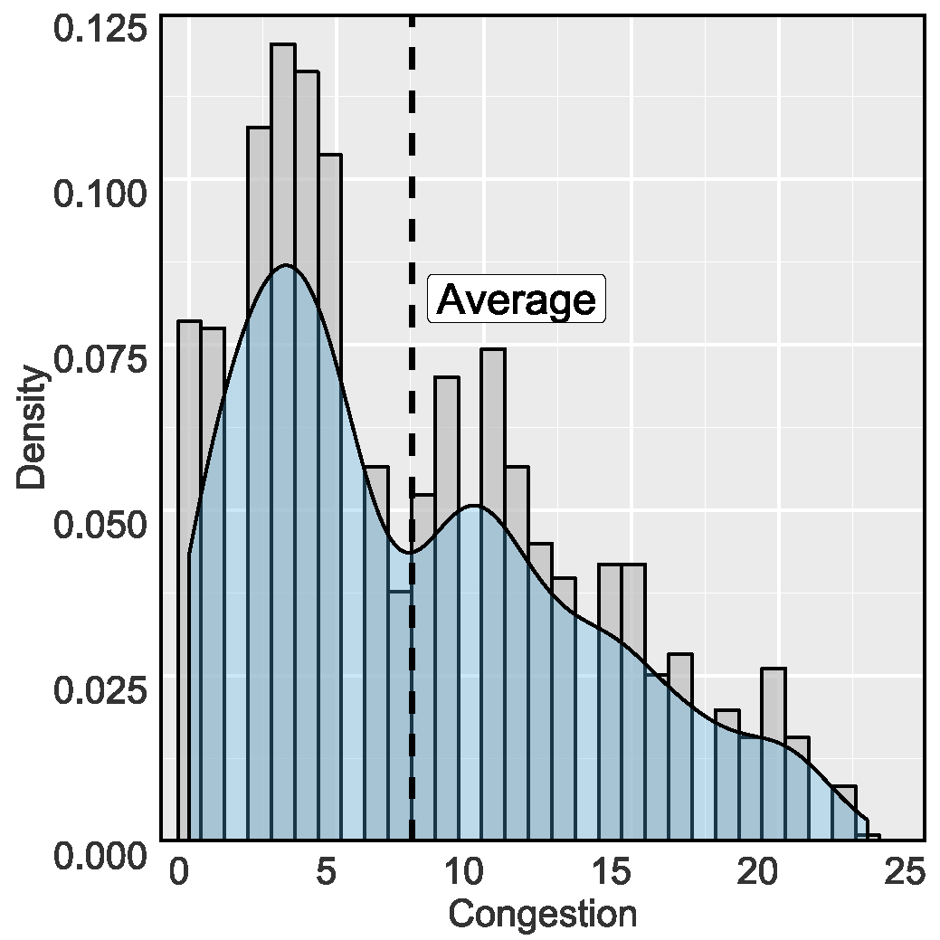
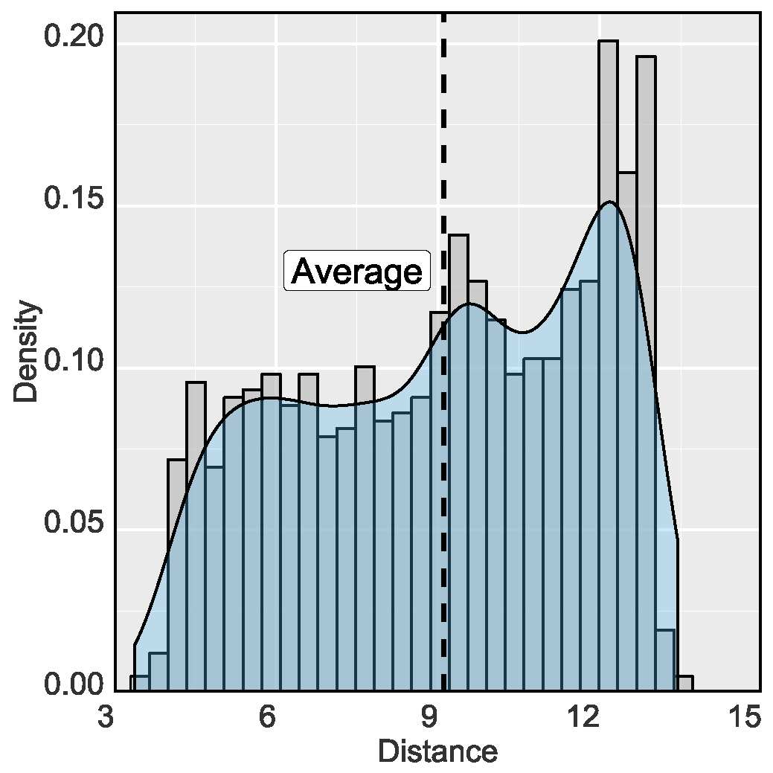
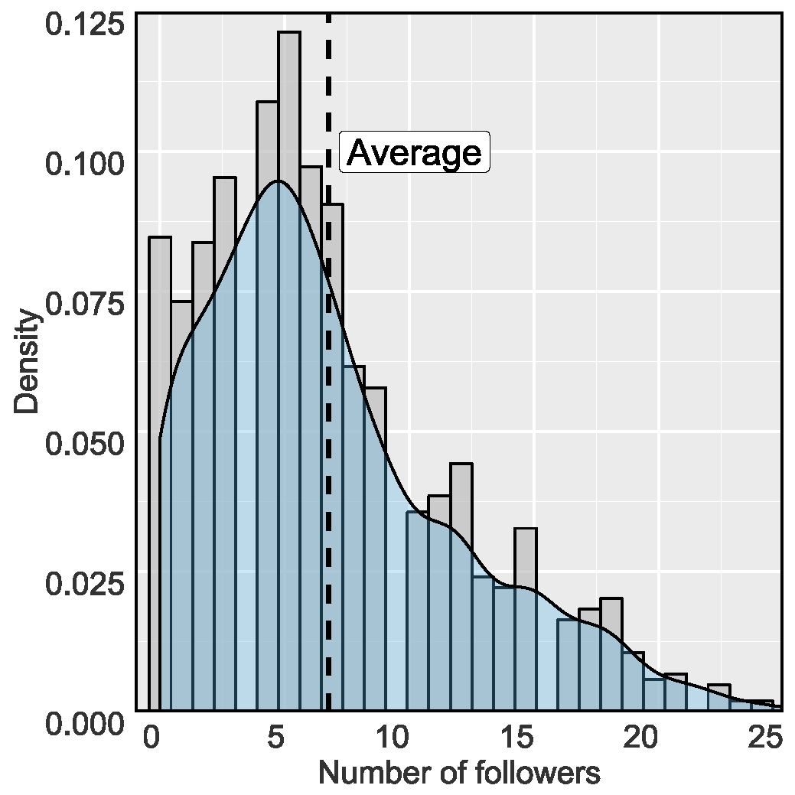
Chapter 3 Crowd Dynamics Model Formulation
Path planning in tactical layer
Classification model
Model training by the data from previous study [1]
Adaboost (ADB): number of estimators = 100
Bagging: max samples=0.5, max features=0.5
Decision Tree (DT): criterion = gini; max depth = 4; min split = 8
Gradient Boosting Decison Tree (GBDT): number of estimators = 200
K-Nearest Neighbor (KNN): number of neighbors to use by default for kneighbors queries = 5
Logistic Regression (LR): Penalty = 12
Multi-Layer Perception (MLP): hidden layers = 2; hidden layer size = (5,2); max iter=1000
Random Forest (RF): criterion = gini; number of trees in the forest = 8
Support Vector Machine (SVM): C penalty = 8; kernel = rbf; probability = True Feature selection
Overview of the variables distribution of the experimental data [1,2]
[1] Haghani, M., & Sarvi, M. (2017). Stated and revealed exit choices of pedestrian crowd evacuees. Transportation Research Part B: Methodological, 95, 238-259.
[2] Haghani, M., & Sarvi, M. (2018). Hypothetical bias and decision-rule effect in modelling discrete directional choices. Transportation Research Part A: Policy and Practice, 116, 361-388.

Slide 36
Chapter 3 Crowd Dynamics Model Formulation
Path planning in tactical layer
Accuracy of optimum ML models on the testing set (data obtained from previous study [1,2])
Accuracy of models in exit choice prediction (ID)
Accuracy
Only judging whether pedestrians choose to visible or invisible exits can get higher accuracy than judging which exit they chose.
The behavior of pedestrians in the data is not entirely logical. For example, in quite a few cases, pedestrians will choose exits that are far away and invisible.
If the coordinate data of pedestrians can be supplemented, better results can be obtained, because the distribution of pedestrians ahead will affect the queue time.
Both methods are used in the crowd dynamics model and the results are compared.
Accuracy of models in exit choice prediction (visible/ invisible)
[1] Haghani, M., & Sarvi, M. (2017). Stated and revealed exit choices of pedestrian crowd evacuees. Transportation Research Part B: Methodological, 95, 238-259.
[2] Haghani, M., & Sarvi, M. (2018). Hypothetical bias and decision-rule effect in modelling discrete directional choices. Transportation Research Part A: Policy and Practice, 116, 361-388.

Slide 37
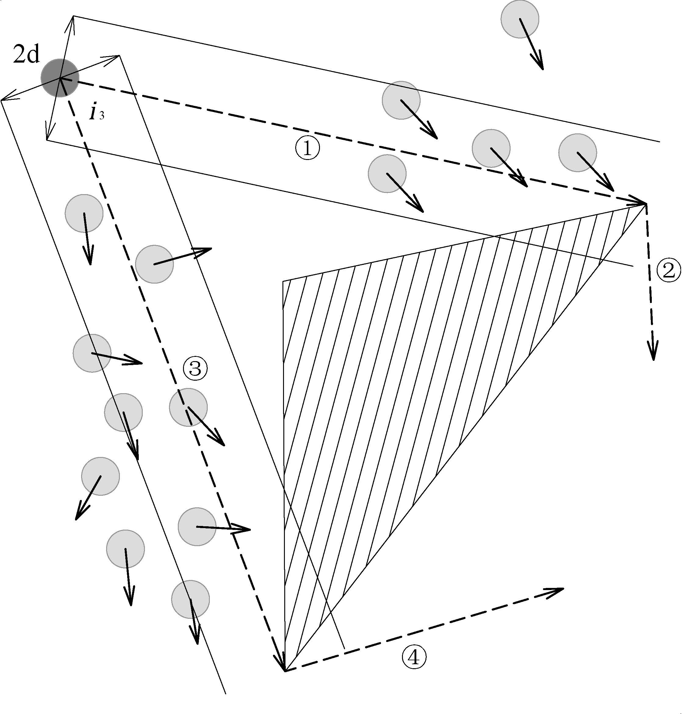
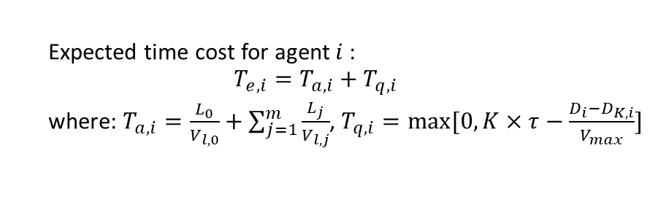
Chapter 3 Crowd Dynamics Model Formulation
Path planning in tactical layer
Velocity observation and estimation
Expected moving velocity along certain link is defined as the average of other pedestrian’s velocity projections the desired direction of observer. (link 1, 3)
Expected moving velocity of the link out of the vision field is estimated as a reduction of velocity in previous link. (link 2, 4)
Expected time cost to pass a certain route is the sum of the distance divided by the velocity.
Time-based path planning
Instead of representing the travel cost of each route by fusion value, this model obtains the expected time cost bypasses the relationship between density and speed.
Expected time cost for agent$i$:
$$T_{e,i}=T_{a,i}+T_{q,i}$$
where: $T_{a,i}=\frac{L_{0}}{V_{l,0}}+\sum_{j=1}^{m}{\frac{L_{j}}{V_{l,j}}}$, $T_{q,i}=max⁡[0, K×τ−\frac{D_{i}−D_{K,i}}{V_{max}}]$
Example of network[1]
[1] https://mathinsight.org/network_introduction

Slide 38
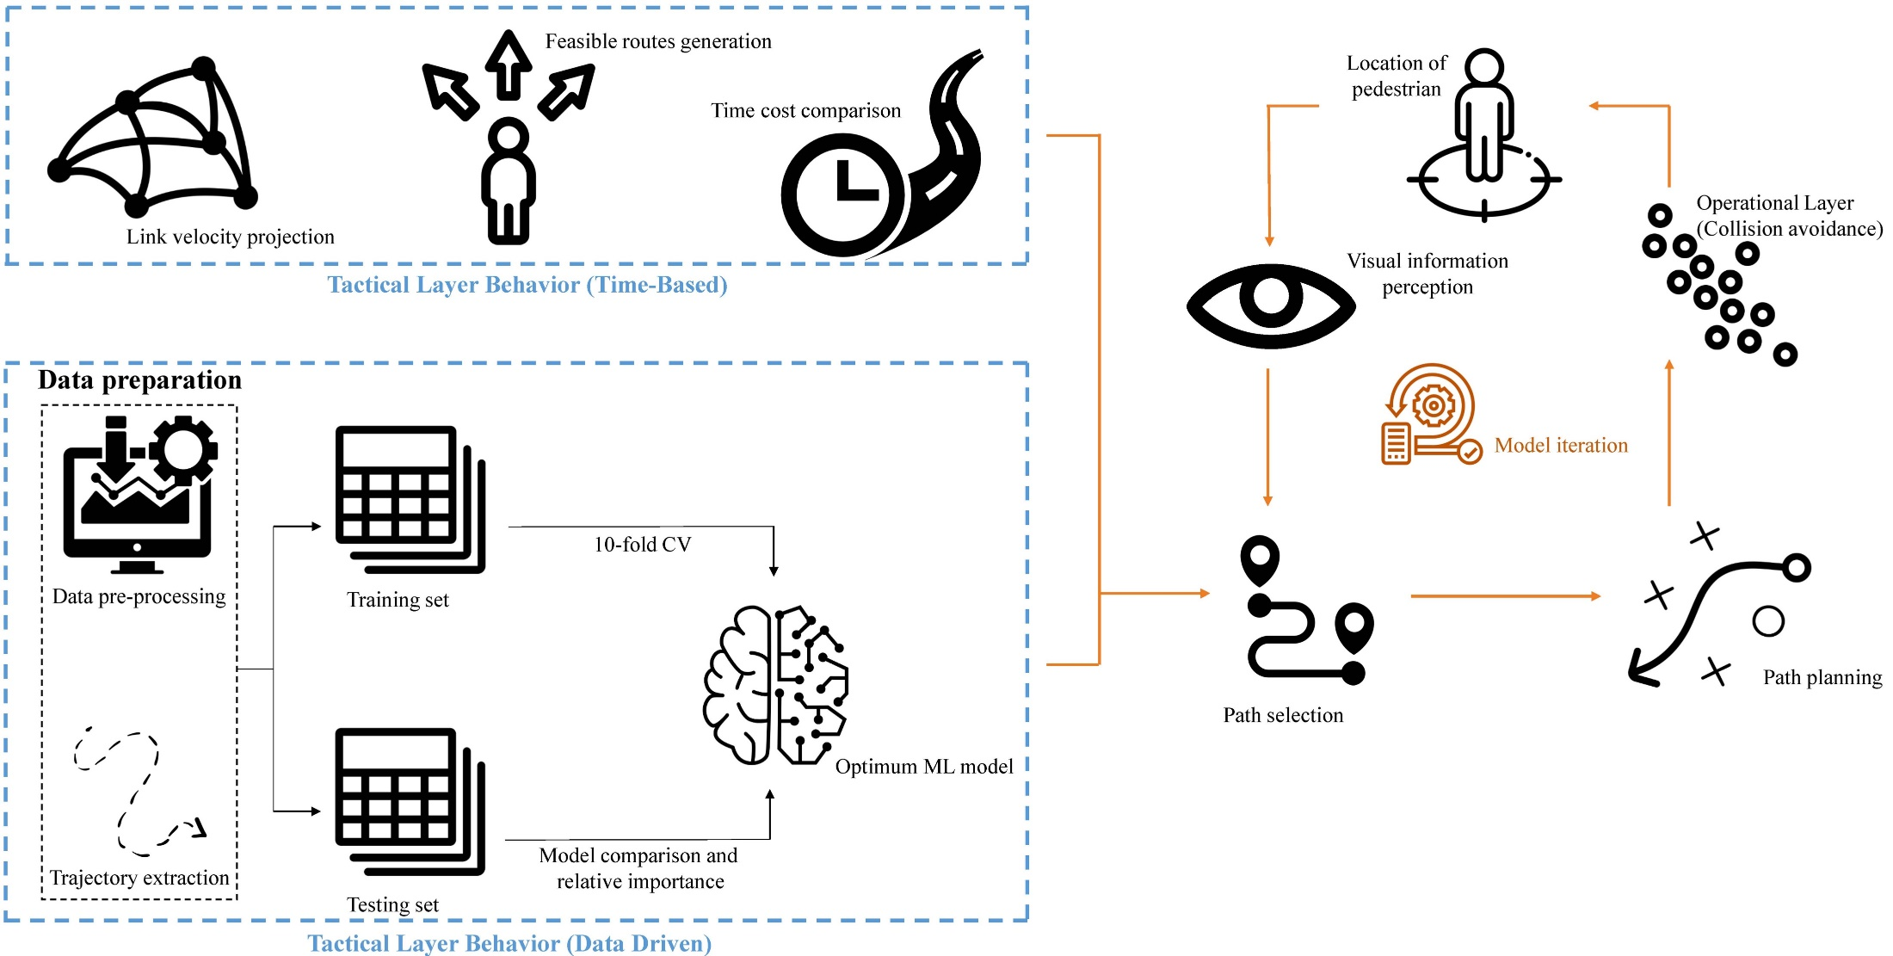
Chapter 3 Crowd Dynamics Model Formulation
Operational Layer Movement planning
Framework of time-based/ data-driven bi-layer model

Slide 39
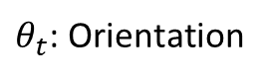
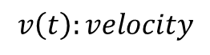
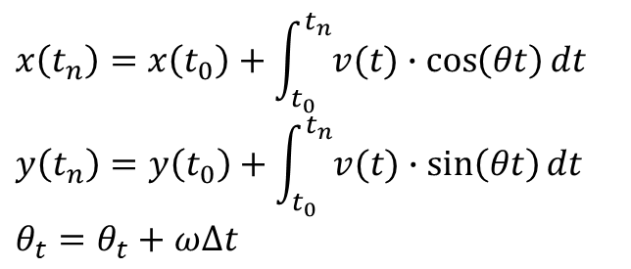
Chapter 3 Crowd Dynamics Model Formulation
Operational Layer Movement planning
Dynamic Window Approach
In robotics motion planning, the dynamic window approach is an online collision avoidance strategy for mobile robots (agents), which derived directly from the dynamics of the robot, and is especially designed to deal with the constraints imposed by limited velocities and accelerations of the robot.
Basic movement functions
$$v\left(t\right):velocity$$
$θ_{t}$: Orientation
A demo of DWA model, 5 agents move from
O(origin) to D(destination)
$$x\left(t_{n}\right)=x\left(t_{0}\right)+\int_{t_{0}}^{t_{n}}{v(t)∙\cos\left(θt\right)}dt$$
$$y\left(t_{n}\right)=y\left(t_{0}\right)+\int_{t_{0}}^{t_{n}}{v(t)∙\sin\left(θt\right)}dt$$
$$θ_{t}=θ_{t}+ω∆t$$

Slide 40
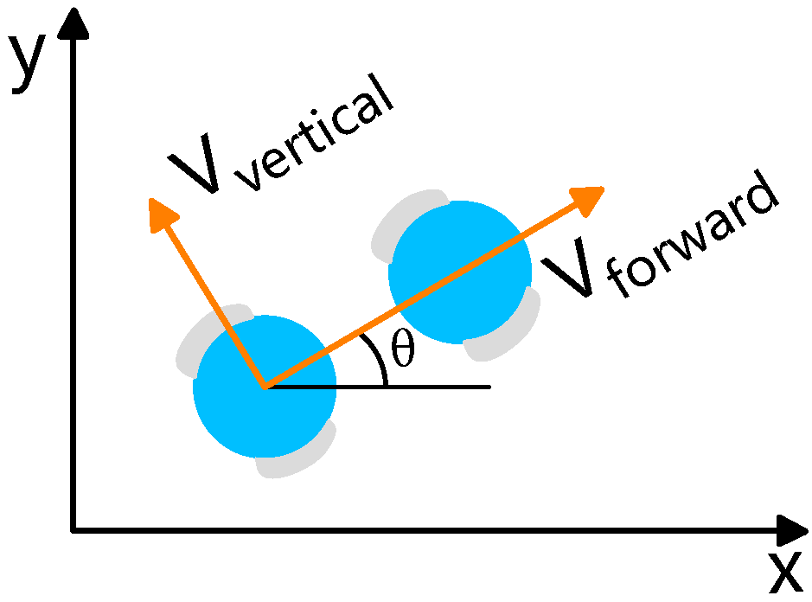
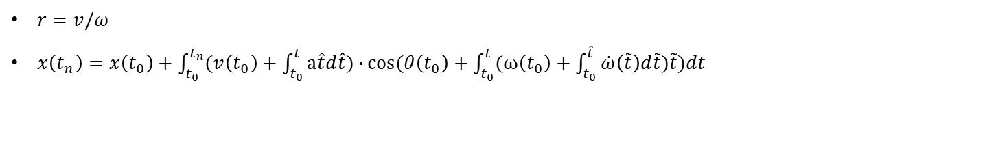
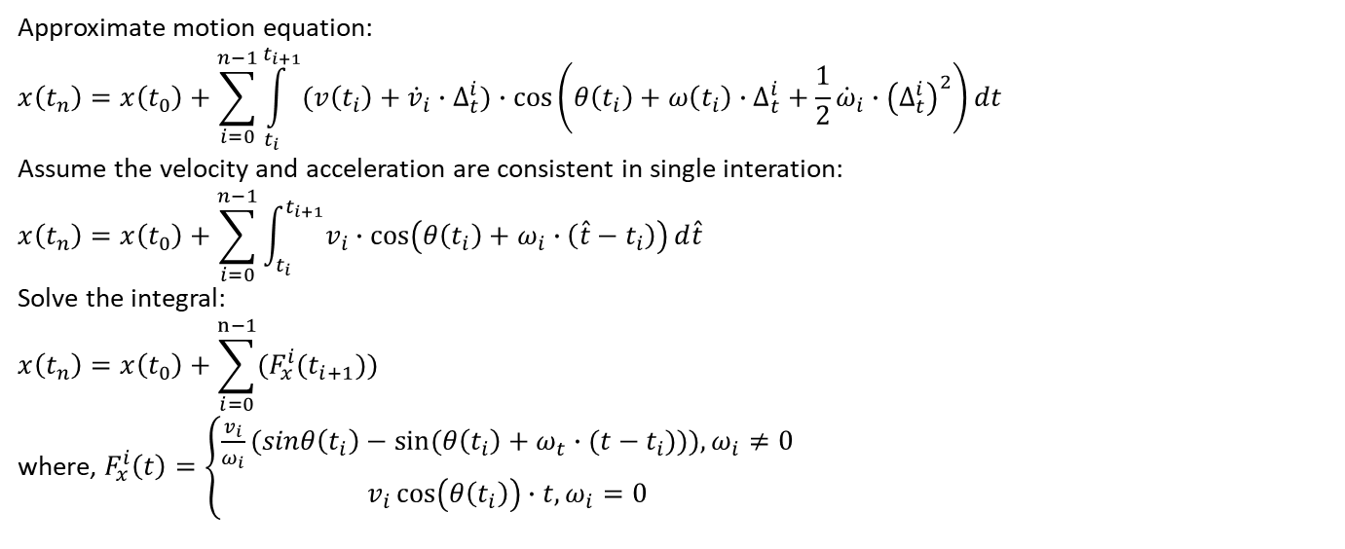
Chapter 3 Crowd Dynamics Model Formulation
Operational Layer Movement planning
Theoretical formulation to discrete iteration (Function with four variables)
$r=v/ω$
$x\left(t_{n}\right)=x\left(t_{0}\right)+\int_{t_{0}}^{t_{n}}{(v\left(t_{0}\right)+\int_{t_{0}}^{t}{a\hat{t}d\hat{t}})∙}cos⁡(θ\left(t_{0}\right)+\int_{t_{0}}^{t}{(ω\left(t_{0}\right)+\int_{t_{0}}^{\hat{t}}{\dot{ω}\left(\tilde{t}\right)d\tilde{t}}})\tilde{t})dt$
Approximate motion equation:
$$x\left(t_{n}\right)=x\left(t_{0}\right)+\sum_{i=0}^{n−1}{\int_{t_{i}}^{t_{i+1}}{(v\left(t_{i}\right)+{\dot{v}}_{i}∙∆_{t}^{i})∙\cos\left(θ\left(t_{i}\right)+ω\left(t_{i}\right)∙∆_{t}^{i}+\frac{1}{2}{\dot{ω}}_{i}∙{\left(∆_{t}^{i}\right)}^{2}\right)dt}}$$
Assume the velocity and acceleration are consistent in single interation:
$$x\left(t_{n}\right)=x\left(t_{0}\right)+\sum_{i=0}^{n−1}{\int_{t_{i}}^{t_{i+1}}{v_{i}}}∙\cos\left(θ\left(t_{i}\right)+ω_{i}∙\left(\hat{t}−t_{i}\right)\right)d\hat{t}$$
Solve the integral:
$$x\left(t_{n}\right)=x\left(t_{0}\right)+\sum_{i=0}^{n−1}{(F_{x}^{i}(t_{i+1}))}$$
where, $F_{x}^{i}\left(t\right)=\left\{\begin{matrix}\frac{v_{i}}{ω_{i}}(sinθ\left(t_{i}\right)−sin⁡(θ\left(t_{i}\right)+ω_{t}∙(t−t_{i}))),ω_{i}≠0 \\ v_{i}\cos\left(θ\left(t_{i}\right)\right)∙t,ω_{i}=0\end{matrix}\right.$
Illustration of coordinate update of DWA method [1]at single time interval
[1] Fox, D., Burgard, W., & Thrun, S. (1997). The dynamic window approach to collision avoidance. IEEE Robotics & Automation Magazine, 4(1), 23-33.

Slide 41
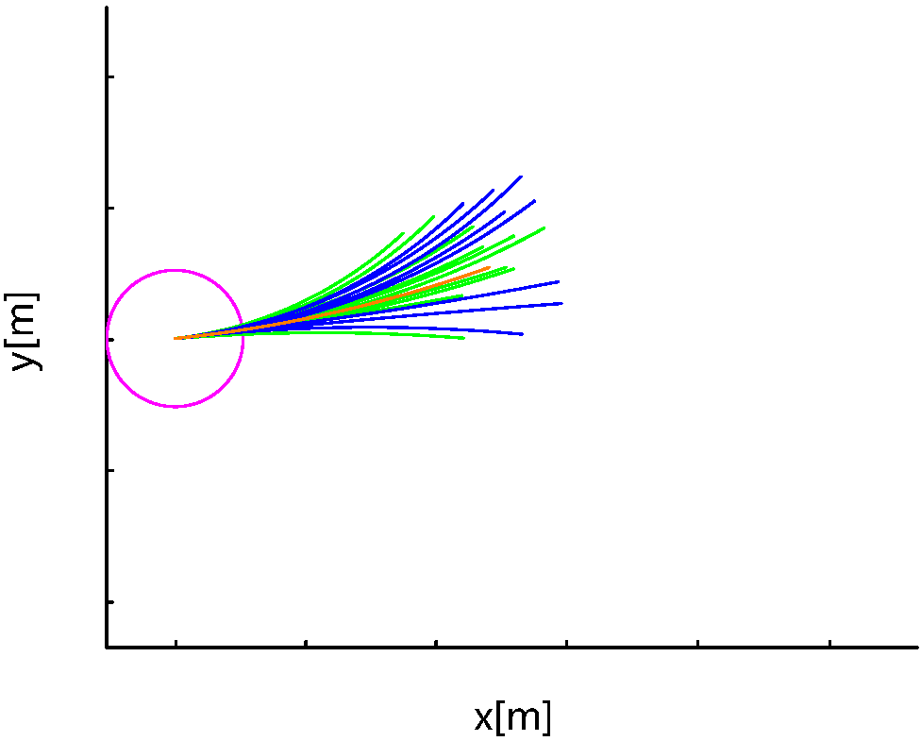
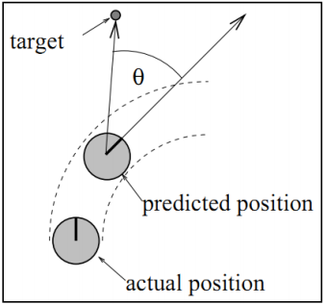
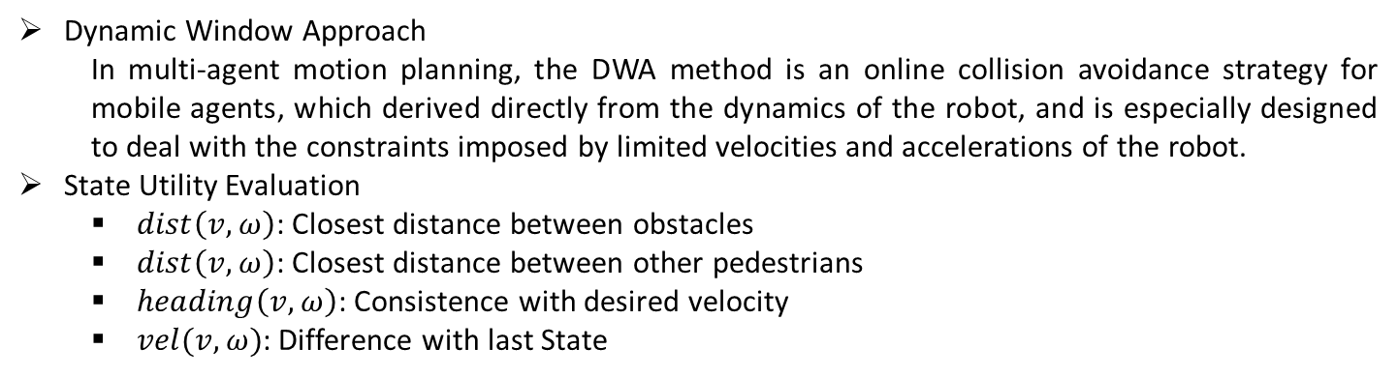
Chapter 3 Crowd Dynamics Model Formulation
Operational Layer Movement planning
Optional trajectories arc of DWA method [1] for agent at a single time interval
Trajectory evaluation [2]
Dynamic Window Approach
In multi-agent motion planning, the DWA method is an online collision avoidance strategy for mobile agents, which derived directly from the dynamics of the robot, and is especially designed to deal with the constraints imposed by limited velocities and accelerations of the robot.
State Utility Evaluation
$dist\left(v,ω\right)$: Closest distance between obstacles
$dist\left(v,ω\right)$: Closest distance between other pedestrians
$heading\left(v,ω\right)$: Consistence with desired velocity
$vel(v,ω)$: Difference with last State
$$G(v,ω)=σ(W_{H}∙heading\left(v,ω\right)+W_{D}∙dist\left(v,ω\right)+W_{V}∙vel(v,ω))$$
[1] Ogren, P., & Leonard, N. E. (2005). A convergent dynamic window approach to obstacle avoidance. IEEE Transactions on Robotics, 21(2), 188-195.
[2] Fox, D., Burgard, W., & Thrun, S. (1997). The dynamic window approach to collision avoidance. IEEE Robotics & Automation Magazine, 4(1), 23-33.

Slide 42
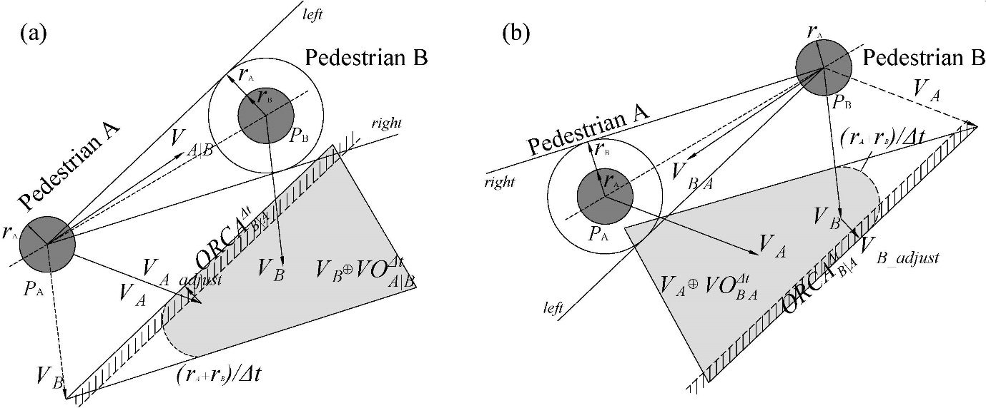
Chapter 3 Crowd Dynamics Model Formulation
Operational Layer Movement planning
Optimal Reciprocal Collision avoidance (ORCA) method
First order formulation
Upper layer delivers a selected goal position to agent so that the agent get desired velocity.
Pedestrians plan their path to avoid collision with obstacles and other pedestrians by scanning for possible collisions in the next time step.
Minimize the velocity adjustment in this procedure.
The velocity obstacle ${VO}_{A|B}^{∆t}(V_{B})$ of a disc-shaped pedestrian B to pedestrian A, and visa versa.

Slide 43
Chapter 3 Crowd Dynamics Model Formulation
Comparison with the potential driven models
Visual information transmission in cellular automata model
The cellular automata model is a very classic discrete model. When the model is applied in pedestrian simulation, the space is often divided into uniform square grids, also called cell.
Each cell can be occupied by single individual
Cells are valued by both static field and dynamic field
The spread of potential in the dynamic field presents the information transmission in the facility
Individual move to the adjacent cell with higher utility in each iteration
The spread of potential in the dynamic field are speed up and the range of influence is scale-up to represent the ability of visual information perception.
If The potential in the dynamic field decays too fast, pedestrian decision-making tends to choose the shortest path.
A long duration will lead to outdated information affecting pedestrian decision-making.
The expansion of potential inevitably incorporates some redundant information

Slide 44
Chapter 3 Crowd Dynamics Model Formulation
Comparison with the potential driven models
Snapshots of pedestrian evacuation in cellular automate model and proposed model.

Slide 45
Chapter 3 Crowd Dynamics Model Formulation
Comparison with the potential driven models
Brief summary
Performance
According to the phenomena observed in the simulation, the microscopic pedestrian model with a visual field-based upper guidance layer and velocity obstacle-based local navigation work well with various space shapes and visibility conditions. The proposed model holds advantages over the potential field model in visual information perception and movement description. In addition, as the algorithmic complexity of this method is no longer linked to space size, it performs better in simulating evacuation from large-scale spaces with irregular shapes. When congestion is considered, the influence of unrelated pedestrians is excluded from decision space and the congestion level is no longer evaluated by the number of pedestrians but rather the flow velocity of pedestrians in the specific area.
Application scene
Irregular space
Information-sensitive group
Facility with visibility diversity
Multi-exit
Large public space with multi-directional pedestrian flow

Slide 46
Topics in subsequent chapters
Reproduce / Predict Pedestrian Flow
Evacuation from classroom under good and zero visibility
Validate the performance of the model with experimental data
Compare the evacuation characteristics in different visibility condition
Evacuation from the space with internal obstacle and multi exits
The model can describe various spatial shapes and visibility condition without being restricted by the structure of the guidance layer.
The introduction of data-driven methods has broken the barriers between empirical research and simulation.
Discuss the decision preference of pedestrians and influence on evacuation result
Analyze the impact of component in visual informaiton and related influence in decision making behavior
Mutil-directional pedestrian flow simualtion
Exploring the flow threshold in the context of continuous pedestrian flow
Simulate pedestrian dynamics in public spaces under different visual conditions

Slide 47
Chapter 4 Pedestrian flow navigated by anthropomorphic regulation
Limitations in previous studies
Psychological behavior
Path utility evaluation regulation based on accessible potential: the potential in previous models is a generalized travel cost that is a fusion of multiple indicators (distance, congestion, leadership, herding behavior) with some guiding significance, its physical meaning is unclear. As an important indicator, how to convert it to generalized travel cost still depends on empirical or intuitive evaluation rules.
Occlusion of the visual field caused by internal obstacles: among the given pedestrian–simulation models, especially potential driven models, the pedestrians have the same visual field. It is assumed that the pedestrians hold a common visual perception system, no matter where they are scattered.
Physical behavior
Visual field extraction from certain space: Although many studies have linked visual information with pedestrian’s decision making behavior, but the description of the visual field is not accurate.
Movement pattern of the agent in the simulation field: Comparing with gird driven model, the guidance layer gives a reasonable description of expected time cost of alternative route, the local navigation layer (ORCA algorithm) hold advantage on pedestrian trajectory simulation.

Slide 48
Chapter 4 Pedestrian flow navigated by anthropomorphic regulation
Time based path planning and crowd dynamics
Evacuation from classroom under good and zero visibility
The description of space is relatively easy, it has been studied by many scholars and provides good comparative data. The results of the model can fit the data in previous studies well.
Psychological decision-making level of the model uses travel time to measure utility
Physical level: a more realistic obstacle avoidance algorithm based on velocity-obstacle method is adopted
Evacuation from the space with internal obstacle and multi exits
Experiment data
Video record[1][2]
Tactical level module
Time based path planning
Space
Classroom
Evacuation space delimited by partitions
[1] Guo, R. Y., Huang, H. J., & Wong, S. C. (2012). Route choice in pedestrian evacuation under conditions of good and zero visibility: Experimental and simulation results. Transportation research part B: methodological, 46(6), 669-686.
[2] Haghani, M., & Sarvi, M. (2017). Stated and revealed exit choices of pedestrian crowd evacuees. Transportation Research Part B: Methodological, 95, 238-259.

Slide 49


Chapter 4 Pedestrian flow navigated by anthropomorphic regulation
Evacuation drill from classroom
Evacuation drill conducted in a classroom[1]
Illustration of the layout of classroom and feasible initial positions in experiment [1]. Initial positions are denoted by 78 numbered circles.
Data feature:
Initial position of volunteers, route choice result of volunteers, evacuation time of volunteers
Configuration: 30 agents distribute in 78 valid positions, 12 sets (6 good 6 zero visibility)
Visibility condition: Good and Zero
[1] Guo, R. Y., Huang, H. J., & Wong, S. C. (2012). Route choice in pedestrian evacuation under conditions of good and zero visibility: Experimental and simulation results. Transportation research part B: methodological, 46(6), 669-686.

Slide 50

Chapter 4 Pedestrian flow navigated by anthropomorphic regulation
Simulation of evacuation under good and zero visibility
Zero
Global guidance
Local navigation
Agent counting
Velocity observation
Vision field occlusion
Good
Global guidance
Local navigation
Agent counting
Velocity observation
Vision field occlusion
Framework of the pedestrian flow model navigated by anthropomorphic regulation

Slide 51
Chapter 4 Pedestrian flow navigated by anthropomorphic regulation
Schema of pedestrian evacuation under zero and good visibility
Time step = 20
Time step = 60
Time step = 100
Time step = 140
Zero
Good

Slide 52






Chapter 4 Pedestrian flow navigated by anthropomorphic regulation
Comparison between evacuation times of pedestrians obtained from experiments [1] and simulations (zero visibility)
Free walk velocities obtained from in this model (unit:m/s):
Simulation 1: 0.32
Simulation 2: 0.41
Simulation 3: 0.39
Simulation 4: 0.39
Simulation 5: 0.40
Simulation 6: 0.38
Free walk velocities obtained from Guo’s study [1] (unit:m/s):
Simulation 1: 0.38
Simulation 2: 0.48
Simulation 3: 0.48
Simulation 4: 0.49
Simulation 5: 0.51
Simulation 6: 0.50
[1] Guo, R. Y., Huang, H. J., & Wong, S. C. (2012). Route choice in pedestrian evacuation under conditions of good and zero visibility: Experimental and simulation results. Transportation research part B: methodological, 46(6), 669-686.

Slide 53






Chapter 4 Pedestrian flow navigated by anthropomorphic regulation
Comparison between evacuation times of pedestrians obtained from experiments [1] and simulations (good visibility)
Free walk velocities obtained from in this model (unit:m/s):
Simulation 1: 0.79
Simulation 2: 0.76
Simulation 3: 0.74
Simulation 4: 0.74
Simulation 5: 0.78
Simulation 6: 0.68
Free walk velocities obtained from Guo’s study [1] (unit:m/s):
Simulation 1: 1.11
Simulation 2: 1.05
Simulation 3: 1.00
Simulation 4: 1.05
Simulation 5: 1.05
Simulation 6: 0.91
[1] Guo, R. Y., Huang, H. J., & Wong, S. C. (2012). Route choice in pedestrian evacuation under conditions of good and zero visibility: Experimental and simulation results. Transportation research part B: methodological, 46(6), 669-686.

Slide 54


Chapter 4 Pedestrian flow navigated by anthropomorphic regulation
Evacuation drill from irregular layout with limited visibility (occlusion of obstacle)
Delaunay triangulation of the set contains vertices and intersection points
Illustration of the layout of evacuation room with four half-meter wide exit in empirical research counducted by Haghani [1] (unit: m).
Activated modules in this scenario
Global guidance
Local navigation
Agent counting
Velocity observation
Vision field occlusion
Mutual visibility of among pedestrians located in triangles
[1] Haghani, M., & Sarvi, M. (2018). Hypothetical bias and decision-rule effect in modelling discrete directional choices. Transportation Research Part A: Policy and Practice, 116, 361-388.

Slide 55






Chapter 4 Pedestrian flow navigated by anthropomorphic regulation
Simulation of evacuation under limited visibility
Time cost $T_{e,i}$ of the optional route for pedestrian $i$
$T_{e,i}=T_{a,i}$+$T_{q,i}$
$$T_{a,i}=\sum_{j=1}^{m}{\frac{L_{j}}{V_{l,j}}}$$
$V_{l,j}$=$\left\{\begin{aligned}\frac{1}{k}\sum_{i=1}^{k}{V_{i}\frac{\overset{⃑}{l_{j}}}{\left|\overset{⃑}{l_{j}}\right|}} if the endpoints of link j are visible \\ αV_{l,j−1} else\end{aligned}\right.$
$$T_{q,i}=\max_{}{[0,Kτ−\frac{D_{i}−D_{K,i}}{V_{max}}]}$$
$$T_{a,i}$$ | Access time
$$T_{q,i}$$ | Queue time
$$L_{j}$$ | Length of link $j$
$$V_{l,j}$$ | Velocity projection on $L_{j}$
$$D_{i}$$ | Distance from pedestrian $i$ to exit
$$D_{K,i}$$ | Distance from the former pedestrian to exit
$$K$$ | The number of visible pedestrians
$$k$$ | Number of pedestrians within threshold Distance to link $\overset{⃑}{l_{j}}$
$$α$$ | Expected coefficient for the velocity
$$τ$$ | Expected time cost for pedestrian to pass exit

Slide 56



Chapter 4 Pedestrian flow navigated by anthropomorphic regulation
Exit choice and evacuation time
Radical and conservative attitude in decision preference
Expected flow velocity in invisible area from the perspective of agent ($α$)
Time cost for one agent to pass exit ($τ$)
Higher 𝛼 means the agents hold positive attitude towards the congestion level in invisible area.
Higher 𝛼 results in the decrease number of agents selecting exit 1and 2.
Higher $τ$ stimulate the pedestrians to be more evenly distributed to each exit
Relation of the number of pedestrians selecting exit in visible area (exit 1 and 2) to parameter $α$ and $τ$

Slide 57



Chapter 4 Pedestrian flow navigated by anthropomorphic regulation
Simulation for pedestrian hold limited visibility ($τ=0.3$; $α=0.8, 1.6$)
$α=0.8$: almost all pedestrian select exit in left side(visible)
$α↑$: Pedestrians have become more positive towards unknown areas, and the number of people choosing invisible exits has increased
Constantly adjusting these two key parameters can keep the model close to the scenario in the experiment
$$α=0.8$$
$$α=1.6$$
T=100
T=300
T=500

Slide 58


Chapter 4 Pedestrian flow navigated by anthropomorphic regulation
Exit choice and evacuation time
Simulation for pedestrian hold limited visibility ($τ=0.3$; $α=0.8, 1.6$)
$α=0.8$: almost all pedestrian select exit in left side(visible)
$α↑$: Pedestrians have become more positive towards unknown areas, and the number of people choosing invisible exits has increased
Constantly adjusting these two key parameters can keep the model close to the scenario in the experiment
Total evacuation time and pedestrian route choice summation under different parameter pairs ($α$ and $τ$) and comparison with result of experiment conducted by previous study [1,2]
[1] Haghani, M., & Sarvi, M. (2017). Stated and revealed exit choices of pedestrian crowd evacuees. Transportation Research Part B: Methodological, 95, 238-259.
[2] Haghani, M., & Sarvi, M. (2018). Hypothetical bias and decision-rule effect in modelling discrete directional choices. Transportation Research Part A: Policy and Practice, 116, 361-388.

Slide 59
Chapter 4 Pedestrian flow navigated by anthropomorphic regulation
Brief summary
Provides an interface that simulates the perception of visual information, and provides a new method for the evaluation of utility
The model can be applied in various scenarios with minor adjustments
Conduct direct comparison between evacuation scenarios that the pedestrian under good, limited and zero visibility
Analyzed pedestrians’ decision-making preferences and their impact on evacuation time
Get rid of potential navigation method
Improve the stability and accuracy of decision information, and filter redundant information
The model no longer needs to update the utility of the cells all over the field, reducing the computational cost
The space does not need to satisfy the features that can be divided, and spaces of various shapes can be modeled
Pave the way for a wider range of application
The perception mode of the individual in the model is the same as in reality, which provides the possibility to connect the results of the experiment
Notes:
45分

Slide 60
Chapter 5 Crowd dynamics simulation driven by ML guidance layer
Limitations in previous chapter
Single feature for decision making
The utility of the path is only measured by the travel time
The role of each feature in decision-making has not been discussed
The calculation rule of travel time is too simple, not fit to the real situation
Different from the vehicle formal pattern, the movement of pedestrians is omnidirectional, so the path velocity (time cost) calculated by the projection method is very unstable
Customized utility does not conform to the pedestrian cognitive pattern
Although travel time is a very important factor, the role of other factors in pedestrian decision-making cannot be ignored
The indoor space is much smaller than the road network, so the boundary between different paths cannot be clearly demarcated
Although the scope of the pedestrian's field of view can be clearly described, the pedestrian may not be able to fully obtain all the information in the real scene
Poor mutual assistance between experiment and simulation
There is no interface between the features extracted in the experiment and the model, only the total evacuation time can be used for comparison

Slide 61
Chapter 5 Crowd dynamics simulation driven by ML guidance layer
Comparison among ML exit choice prediction approaches
Exit choice prediction approaches
Exit choice data extracted from video record [1,2]
Previous studies have collected satisfied data, so that it is possible to train a decision model to simulate the path choice of pedestrians during evacuation
The quantitative method of the characteristic index used for decision-making can not fully describe all the information
Classification methods:
ADB, Bagging, Decision Tree, Gradient Boosting Decision Tree, KNN, Logistic regression, Multilayer perceptron, Random forest, Support vector machine
Exit choice prediction
Only predict the route selected by pedestrians (over 90%)
Predict the exit selected by pedestrians (almost 80%)
Illustration of the layout of evacuation room with four half-meter wide exit in empirical research counducted by Haghani [2] (unit: m).
[1] Haghani, M., & Sarvi, M. (2017). Stated and revealed exit choices of pedestrian crowd evacuees. Transportation Research Part B: Methodological, 95, 238-259.
[2] Haghani, M., & Sarvi, M. (2018). Hypothetical bias and decision-rule effect in modelling discrete directional choices. Transportation Research Part A: Policy and Practice, 116, 361-388.

Slide 62




Chapter 5 Crowd dynamics simulation driven by ML guidance layer
Comparison among ML exit choice prediction approaches
ROC curve and AUC values of prediction models on the testing set for each exit (raw data obtained from Haghani’s work [1,2])
[1] Haghani, M., & Sarvi, M. (2017). Stated and revealed exit choices of pedestrian crowd evacuees. Transportation Research Part B: Methodological, 95, 238-259.
[2] Haghani, M., & Sarvi, M. (2018). Hypothetical bias and decision-rule effect in modelling discrete directional choices. Transportation Research Part A: Policy and Practice, 116, 361-388.

Slide 63



Chapter 5 Crowd dynamics simulation driven by ML guidance layer
Inherent limitation of the experimental data [1]
Data features are too concentrated
Most of pedestrians make decisions at a place far away from the exit
As pedestrians enter the experiment site one by one, the density of pedestrian flow is always low and relatively stable
Pedestrians have a narrow detour space, and pedestrians keep coming in behind, so it is difficult for pedestrians to change their initial choices
Variance distribution of numerical variables in each decision trial (raw data obtained from previous study [1] )
[1] Haghani, M., & Sarvi, M. (2017). Stated and revealed exit choices of pedestrian crowd evacuees. Transportation Research Part B: Methodological, 95, 238-259.
[2] Haghani, M., & Sarvi, M. (2018). Hypothetical bias and decision-rule effect in modelling discrete directional choices. Transportation Research Part A: Policy and Practice, 116, 361-388.

Slide 64
Chapter 5 Crowd dynamics simulation driven by ML guidance layer
Accuracy, precision and recall rate by variance interval to each exit obtained from GBDT and SVM models (these models are trained by the data obtained from [1,2]
The model that predicts the specific exit choice is more sensitive to the congestion level than the model that only predicts the general direction
The sensitivity to the herd behavior is lower than the model that only predicts the general direction. As pedestrians enter the experiment site one by one, the density of pedestrian flow is always low and relatively stable
[1] Haghani, M., & Sarvi, M. (2017). Stated and revealed exit choices of pedestrian crowd evacuees. Transportation Research Part B: Methodological, 95, 238-259.
[2] Haghani, M., & Sarvi, M. (2018). Hypothetical bias and decision-rule effect in modelling discrete directional choices. Transportation Research Part A: Policy and Practice, 116, 361-388.

Slide 65








Chapter 5 Crowd dynamics simulation driven by ML guidance layer
Snapshots of pedestrian evacuation under the condition of limited(A1-A4) and global(B1-B4) visibility at time steps 90, 180, 270, 360.
90
180
270
360

Slide 66
Chapter 5 Crowd dynamics simulation driven by ML guidance layer
Brief summary
Narrow the gap between two research method in crowd dynamic analysis
The results of the empirical analysis can be used not only to verify the model, but also to train the decision-making module
Provides a solution to circumvent the two problems of measurement of features in space and quantification of utility
Analysis about the influence of the features on exit selection
Pedestrians have different decision-making preferences at different stages in the same evacuation process
The classification model can be well trained with only 4 features
The introduction of the visual perception module allows more relevant features to be considered
Pave the way for a wider range of application
The high compatibility of the model makes this method not only applicable to evacuation simulations, but also to the spatial scenes where various pedestrian flows exist
This method can make more efficient use of the results obtained in past empirical research and fill in the gaps in model development

Slide 67
Chapter 6 Multi-directional pedestrians flow simulation
Two feasible extension based on bi-layer simulation model
Disorderly pedestrian flow in large public space (Psychological side)
Excellent compatibility of the model can explore spaces of various shapes
The introduction of visual information can broaden the range of features involved in decision-making
Diversified decision-making modules can be applied to various situations
Data-based utility comparison can handle movement behaviors with different purposes
Mobile convenience oriented internal space design (Physical side)
Based on limited data to predict the flow of people in different spaces, without the need for targeted modeling
Improve the ability to describe individuals in terms of dynamics, so as to evaluate the efficiency of pedestrian flow in existing building spaces
Analyze the intersection phenomenon and related characteristics of pedestrian flows
Analyze the ability of a specific space to withstand the flow of pedestrian and the sudden change threshold of mobility

Slide 68

Chapter 6 Multi-directional pedestrian flow simulation
Pedestrian flow planning in public spaces
In non-emergency situations, pedestrians are more concerned about distance and comfort, and may even travel in groups.
Pedestrians are moving toward different destinations, so their interpretation of the status value of the same location is different. Therefore, we cannot use the data extracted from evacuation drill to train the path planning model in this scenario.
Note: Figure obtain from website (https://www.ptvgroup.com/en/solutions/products/ptv-viswalk/)

Slide 69


Chapter 6 Multi-directional pedestrian flow simulation
Applicable scope and related scenarios
Layout of the intersection zone with obstacles
Example of bidirectional pedestrian flow [1]
Pedestrian flow planning in public spaces
Bi-directional pedestrian flows ($\overset{⃑}{AC}$, $\overset{⃑}{CA}$, $\overset{⃑}{BD}$, $\overset{⃑}{DB}$) in an intersection with 4 square obstacles of a length of 2.4m
Route choice: 2 times
Visibility condition: global / limited
Quantity of the pedestrian flow: N (from 50 to 100)
Tactical layer: Time-based path planning
[1] Zhang, J., Klingsch, W., Schadschneider, A., & Seyfried, A. (2012). Ordering in bidirectional pedestrian flows and its influence on the fundamental diagram. Journal of Statistical Mechanics: Theory and Experiment, 2012(02), P02002.

Slide 70
Chapter 6 Multi-directional pedestrian flow simulation
Applicable scope and related scenarios
Snapshots of crowd dynamics at intersection zone
Limited visibility
Global visibility
Average and standard deviation of pedestrian velocities

Slide 71
Chapter 6 Multi-directional pedestrian flow simulation
Applicable scope and related scenarios
Pedestrian flow planning in public spaces
Proposed model is not limited to evacuation simulations, but can also be extended to more general scenarios. Pedestrians continue to enter the space from the four corners and cross diagonally and leave the space.
Pedestrian flow characteristics in different visibility conditions
The average velocity of pedestrians eventually tends to be less than 80 % of the free walk velocity, while it can exceed 80 % for those with global information
The standard deviation of velocities shows that after the first peak, the pedestrian velocity set with the global perspective is lower than 0.2, while this value can be close to 0.3 with obstacles
Regardless of whether pedestrian hold global or limited visibility, the time step when the standard deviation of velocities reach the peak for the first time is same
In this simulation, there is a threshold in the quantity of pedestrian flow (N=100). The movement characteristics of the flow of people above this value will undergo a sudden change
The model can be used to evaluate the motion characteristics of bidirectional pedestrian flow in other similar scenarios
The result of simulation also reflects that without changing the pedestrian motion attributes, the increase of visual information can significantly improve the efficiency of pedestrian movement, but not significant.

Slide 72
Chapter 7 Summary
Core contributions
The core contribution is to solve various physical and psychological bottlenecks in simulation and continuously improve the authenticity of the model. The difficulty in physics are the ability to describe the layout of architectural space, the compatibility of the guidance field, visual information filter in data preparation, and the smoothness of the pedestrian trajectory. At the psychological level, the difficulty lies in the reproduction of pedestrian decision-making logic and the integration of decision-making frameworks.
Provide additional support to previous route-choice mechanism explanations
Pedestrian’s movement behavior under various visibility conditions are compared
The influence of features in visual information are compared
Route choice behavior is reproduced and validated with previous studies
An attempt to remove the use of the potential field in microscopic representations of pedestrian simulations and choose to guide individuals through a directed network instead
Reduce computing costs
Create a medium for information transmission and filtering
Establish a connection between two isolated research methods, experimental analysis and numerical simulation, improve the authenticity of the model, and broadening the scope of application of the simulation method based on this framework

Slide 73
Chapter 7 Summary
Applicable scope and related scenarios
Visual information
Select direction
Conduct movement
Without suitable data
Collect visible nodes in network
Generate optional route set
Evaluate travel cost by flow velocity
Deliver desired direction for agent
With suitable data
Collect visible agent in visual field
Extract agents’ dynamic information
(selected exit, position, velocity)
Evaluate the utility by ML model
Deliver desired direction for agent
Framework
Empirical analysis can accurately set physical parameters, and simulation can accurately set psychological preferences
For the the space where relevant data exists, the ML model can be used for decision-making guidance, otherwise the time-based utility measurement model can be used
This model can be compatible with the definition needs of both psychological and physical levels in most scenarios

Slide 74
Chapter 7 Summary
Limitations and future work
Bottlenecks in psychology description
The introduction of machine learning solves the problem of confusion of physical units (dimension) but also limits the application scenarios of the model. When it comes to the extension in general scenarios, corresponding path selection data is required. At the same time, the types of features in the data, data distribution, and data quantity also affect the decision-making performance of the model.
Perception methods other than visual information have not yet been described, and there are limitations in the simulation of public space scenarios guided by auxiliary broadcasts.
Bottlenecks in physiology (kinematics) description
The introduction of dynamic window approach pave the way for the analysis of human-obstacle interaction in arbitrary space, but it also cast new dimension vague problem in the model. The solution currently conceivable is to use reinforcement learning to obtain the optimal parameter configuration.
In trajectory planning, the envelope space of pedestrian groups have not been considered. Therefore, pedestrians are assumed to have no social relationship.

Slide 75

Reference:
Zhou, Z., Nakanishi, W., Asakura, Y.: Route choice in the pedestrian evacuation: microscopic formulation based on visual information, Physica A, Vol.562, pp.125313, 2021.
Zhou, Z., Nakanishi, W., Asakura, Y.: Data-driven framework for the adaptive exit selection problem in pedestrian flow: Visual information based heuristics approach, Physica A, Vol. 583, pp.126289, 2021
Zhou, Z., Nakanishi, W., Asakura, Y.: Vision-based crowd dynamic model for multi-directional pedestrian flow at public space: a hybrid approach, Eastern Asia Society for Transportation Studies Conference (submitted)

